Slide 1
Stochastic Uncertainty Analysis for Data-Consistent Approaches to Inverse Problems
Presenter: Tian yu yen
Notes:
Hi everyone, my name is Tian Yu Yen.
I want to thank you all for coming to my dissertation defense today.
Today I am going to be discussing my work on analyzing stochastic uncertainty for data-consistent approaches to inverse problems.

Slide 2
Overall Goal & Outline
Goal: The data-consistent (DCI) approach is a flexible and robust framework for solving inverse problems
Comparative Analysis
Extension to Stochastic Maps
Consequences of Finite Data
Notes:
The focus of my dissertation is on a method called data-consistent inversion (or DCI, for short). This method was developed by my adviser and his collaborators to solve inverse problems.
In general, the main goal of my research was to show that the data-consistent approach is a flexible and robust framework for solving and addressing different types of inverse problems.
In my dissertation, I make three main contributions to the data-consistent approach to inverse problems:
First, I provide a detailed comparison of DCI to more common methods of solving inverse problems, namely the Bayesian approach.
Second, I provide an extension of the data-consistent approach to stochastic maps
Third, I examine the consequences of using finite data on the data-consistent approach
Before we address these contributions, I’d like to start with some background about uncertainty quantification and how it relates to inverse problems.

Slide 3
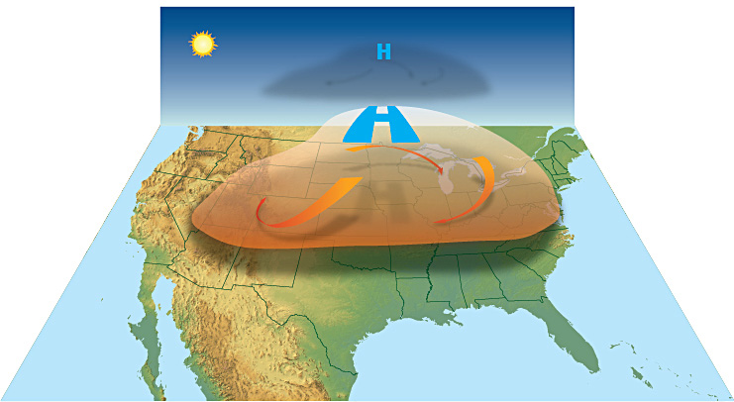
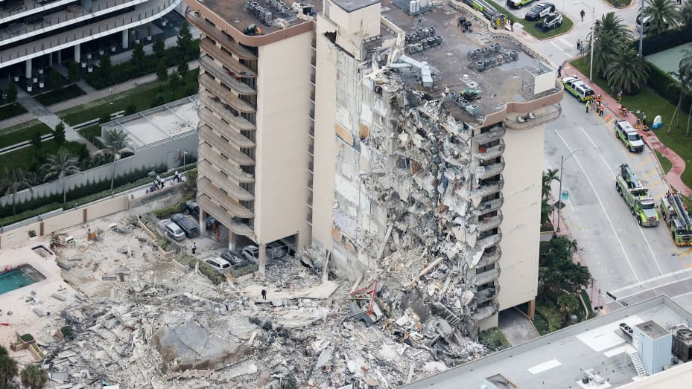
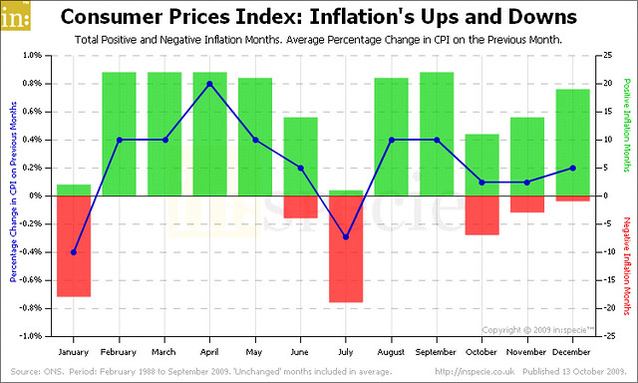
Uncertainty quantification (UQ)
Computational models are everywhere…
The purpose of UQ:
To measure and analyze the uncertainty of inferences and predictions based on these computational models.
Notes:
The field of uncertainty quantification has been rapidly growing in the last decade due to an increased reliance on computational models for a variety of purposes, including
Making predictions and forecasts from weather and climate models
Engineering and design of physical systems
Analyzing economic events and informing public policy
The role of uncertainty quantification in these contexts is to provide accurate measures and analysis of the uncertainty in inferences and predictions made from these models,
And to reduce the uncertainty by incorporating additional data and information when possible.

Slide 4
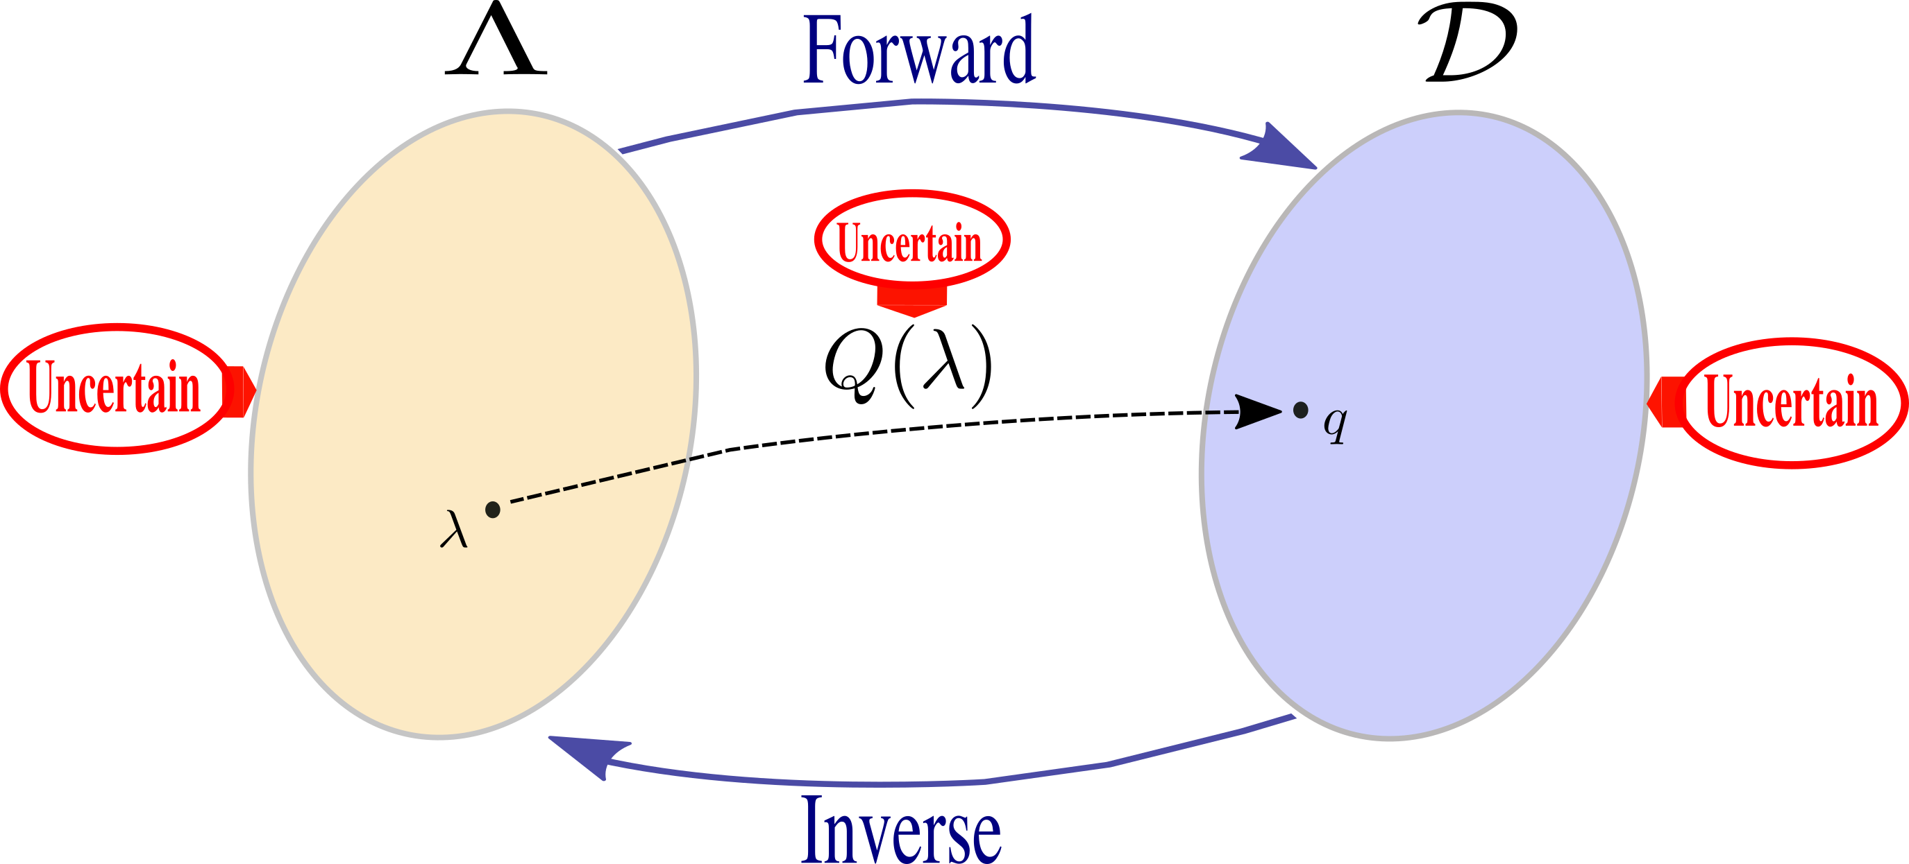

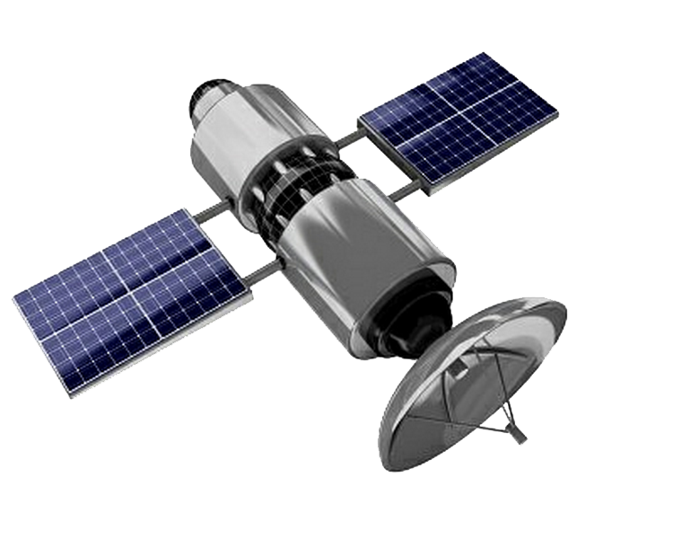
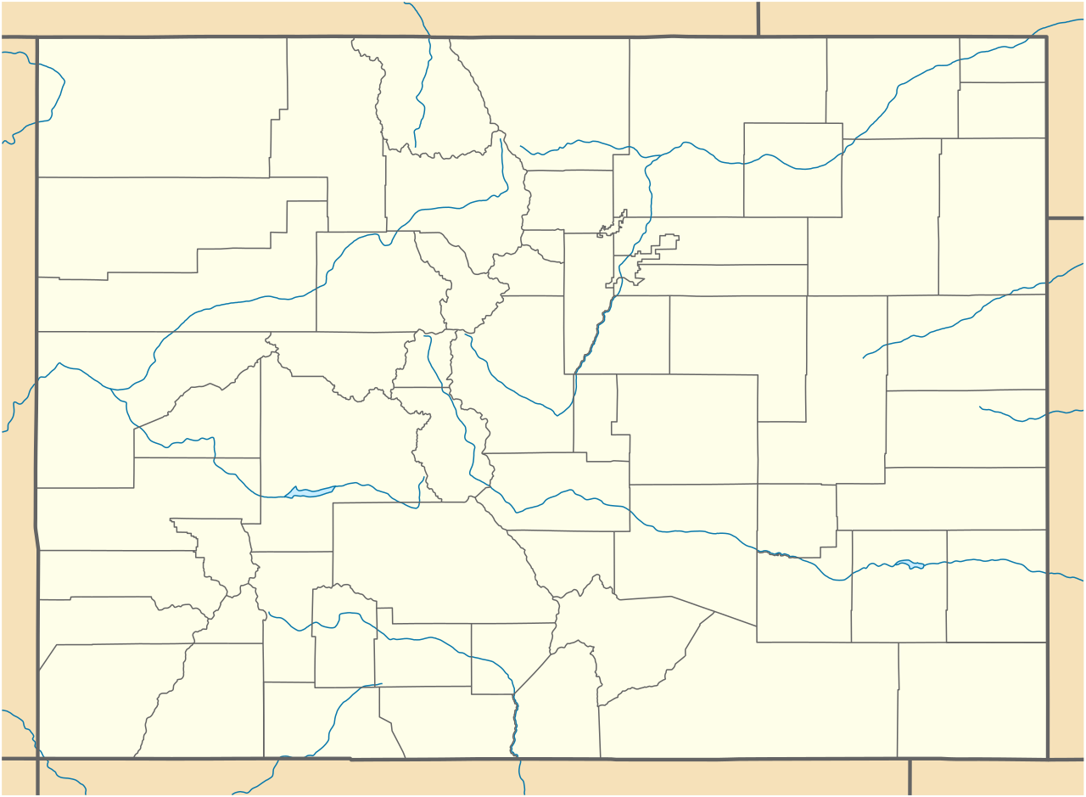
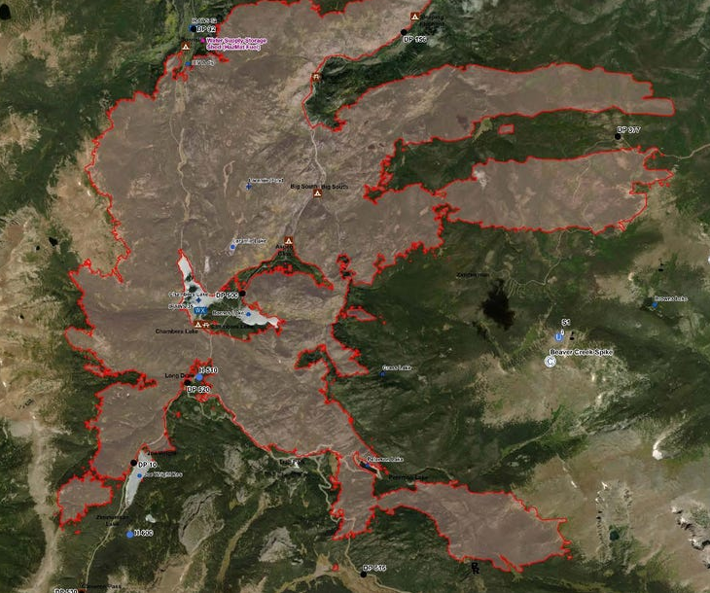
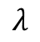
Uncertainty quantification
Forward vs. Inverse Problems
Inverse Problem Challenges
Ill-posed
Additional Uncertainty
Finite Data
How does the data-consistent approach tackle these issues?
$$λ$$
Notes:
There are two main problems in uncertainty quantification: the forward and inverse problem.
Suppose you have a computational model, like a wildfire model.
This model takes parameters of interest (which we will denote by lambda) and maps them to quantities of interest (which we will denote by q)
For instance, the wildfire model might have, as one of its inputs, the ignition point of a wildfire (as the parameter of interest)
And output the current observed edge of the fire front (as the quantity of interest).
In the forward problem, we are interested in determining the uncertainty of predicted quantities of interest (i.e., the fire front) based on uncertainty of our parameter of interest (i.e., the fire start location).
In the inverse problem, we are interested in using observations of the quantity of interest (i.e., the current location of the fire front) to make inferences about the parameter of interest (i.e., where did the fire start?).
In this dissertation, we will focus only on the inverse problem: we want to understand and quantify the uncertainty in our parameter of interest based on information and data from our quantity of interest.
There are a number of common challenges that we face when solving inverse problems:
Inverse problems are typically ill-posed. By this we mean that there are typically multiple possible values for the parameter of interest that could have produced our observations. For instance, two ignition points could lead to the same current observed fire front.
Inverse problems may be subject to additional external uncertainties, either in our computational model or in our observed values. For instance, the wildfire-computational model may not sufficiently capture all of the involved physical processes precisely. Or the observations from satellite data may be especially noisy and inaccurate.
Finally, we may have limited observations with which to make these inferences (i.e., the satellite only provides data on the fire after some number of hours when it completes its orbit)
As part of the main goal of showing that data-consistent inversion is a flexible and robust framework to solve inverse problems, I will show how the data-consistent approach tackles some of these issues.

Slide 5
What type of uncertainty are we quantifying?
Is the parameter of interest subject to epistemic uncertainty?
Systematic uncertainty that could be determined in principle but not known in practice
E.g., fire ignition location
Is the parameter of interest subject to aleotoric uncertainty?
Irreducible uncertainty that occurs each time an experiment or model is run
E.g., pressure field in a turbulent fluid dynamics model
Notes:
Before we solve the inverse problem it is important to clarify…
We can generally classify uncertainties into two categories: epistemic and aleotoric.
Epistemic uncertainty is….For instance, the fire ignition location in a fire model.
There is some true starting point of the wildfire, but it is usually very difficult and resource intensive to determine the exact location / starting point of a wildfire. Thus, the starting location could be determined, but since we do not know its location, it is subject to epistemic uncertainty.
Aleotoric uncertainty is... It is uncertainty that is inherent in the parameter...
For example, the pressure field in a turbulent fluid dynamics model is inherently random. The turbulence is a chaotic system and there is no “true” fixed value of the pressure field: it is subject to aleotoric uncertainty.
This classification of uncertainties for the parameter we are interested in is important because it changes how we should approach the inverse problem and the types of methods we should use to obtain solutions to the inverse problem.

Slide 6
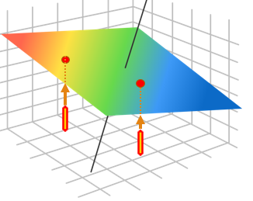
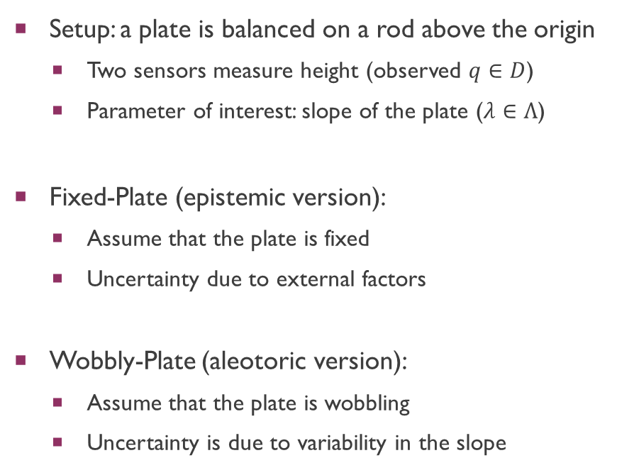
Fixed or Wobbly Plate
Setup: a plate is balanced on a rod above the origin
Two sensors measure height (observed $q∈D$)
Parameter of interest: slope of the plate ($λ∈Λ$)
Fixed-Plate (epistemic version):
Assume that the plate is fixed
Uncertainty due to external factors
Wobbly-Plate (aleotoric version):
Assume that the plate is wobbling
Uncertainty is due to variability in the slope
Notes:
To illustrate these points, we will be looking at a simple computational model that can be described using a linear system of equations.
Consider:
Two sensors measure height
Parameter of interest is the slope of the plate
There are two versions of this problem:
Fixed plate version
Wobbly-plate version
While the model we use is a simplified mathematical model, it is inspired by practical applications.
For instance, the wobbly-plate example is inspired by the use of tiltmeters to measure volcanic activity
or micro-erosion meters (MEM) which measure erosion and are used in environmental and civil engineering applications.

Slide 7
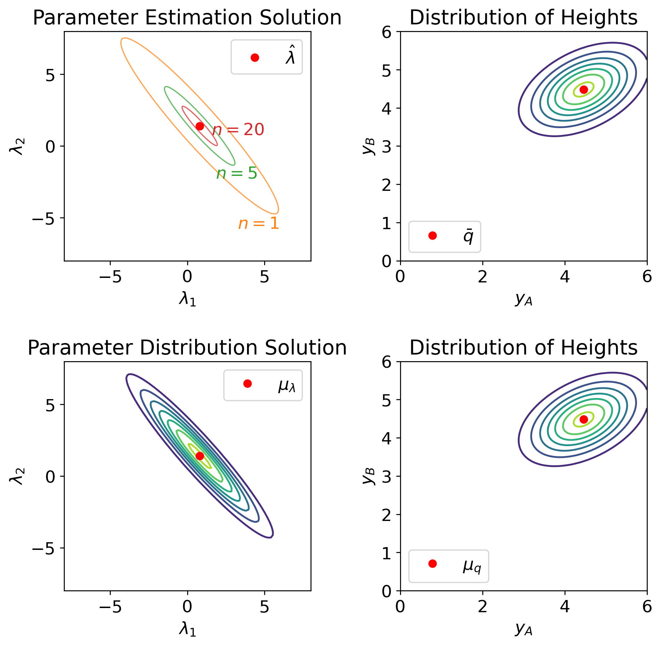
Solutions to inverse problem
Fixed-Plate
Wobbly-Plate
Parameter estimation problem
Parameter distribution problem
Goal: Quantify the uncertainty with probability distributions.
Notes:
The solutions to these two UQ problems are different.
For the parameter estimation problem, we take observations of the heights and are looking for a single value which best represents the “fixed” slope of the plate.
We also want to measure the uncertainty in our estimate of the slope using probability distributions.
This will change as we obtain more observations, with more observations reducing the uncertainty of our estimate (i.e., reducing epistemic uncertainty).
On the other hand, in the distribution problem, we use the observations of the height to help us construct a probability **DISTRIBUTION** which describes the variability of the slopes.
This distribution should not be “reduced” because the plate is wobbling: it is subject to aleotoric uncertainty.

Slide 8
Overall Goal & Outline
Goal: The data-consistent (DCI) approach is a flexible and robust framework for solving inverse problems
Comparative Analysis
Extension to Stochastic Maps
Consequences of Finite Data
Notes:
Now that we have defined our problems, let’s look at the DCI approach and compare it to the commonly used Bayesian approach.

Slide 9
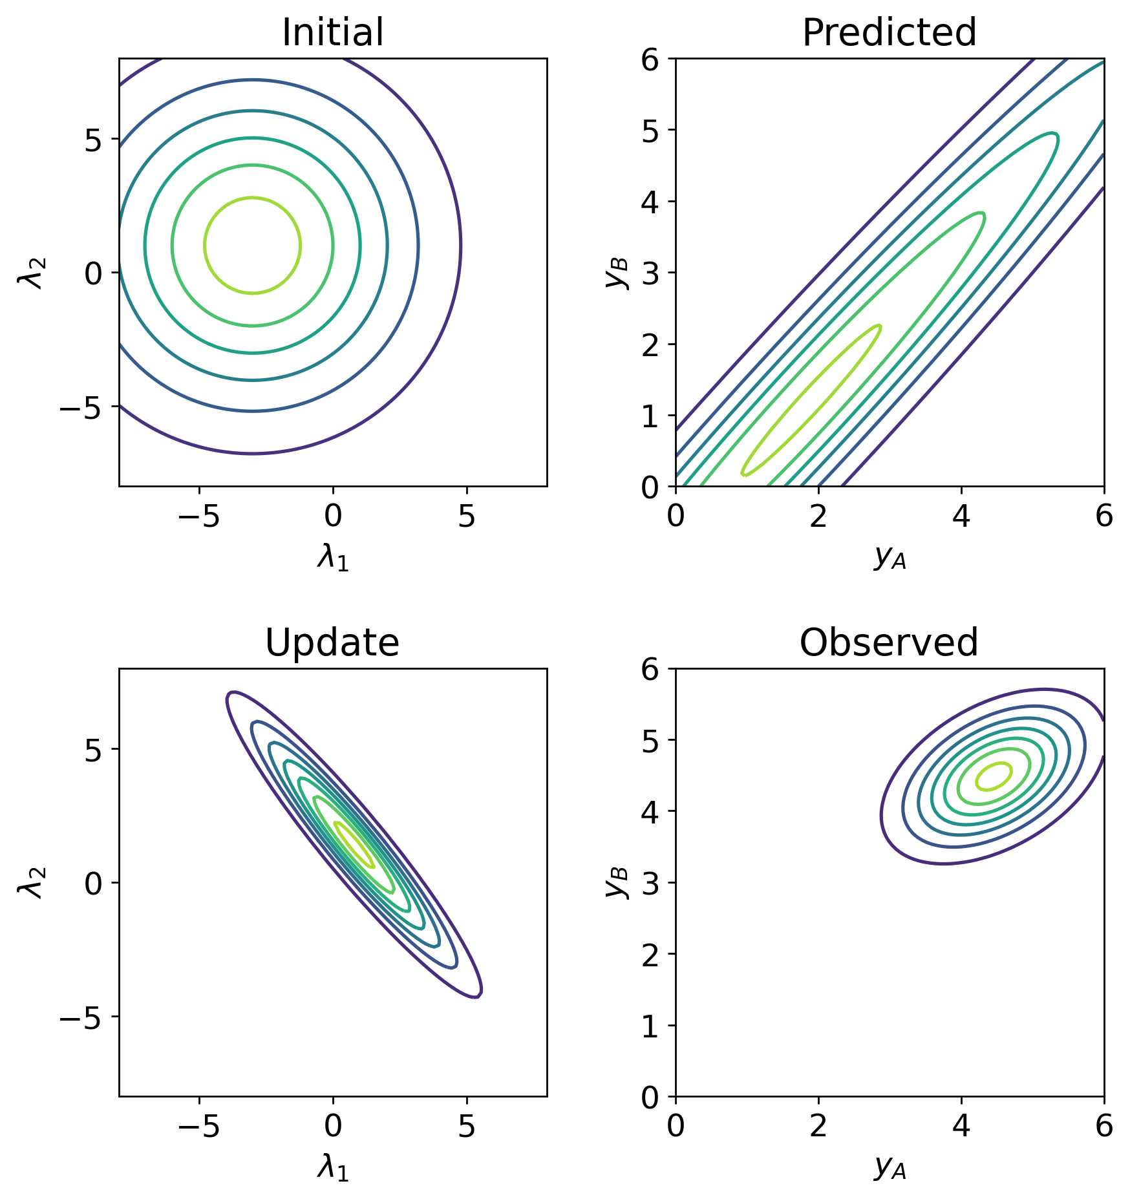
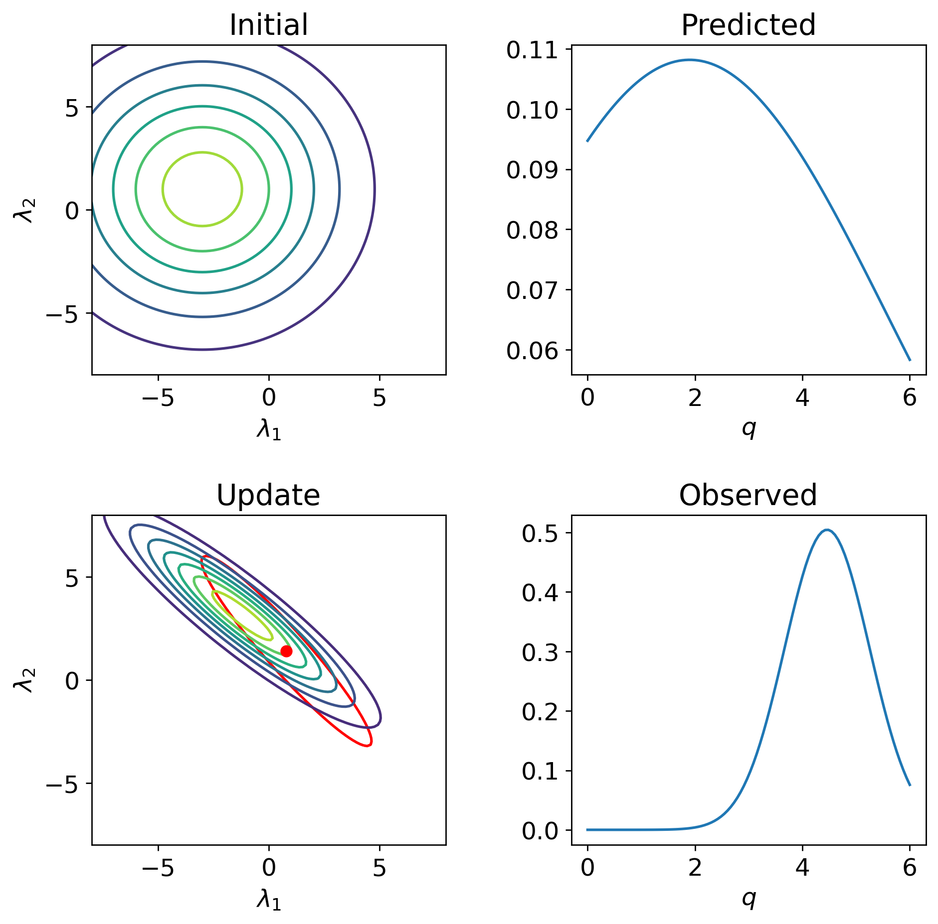
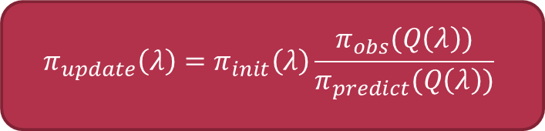
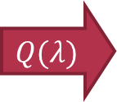

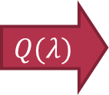
Data-consistent Inversion (DCI)
$$Q(λ)$$
$$π_{update}\left(λ\right)=π_{init}\left(λ\right)\frac{π_{obs}(Q\left(λ\right))}{π_{predict}(Q\left(λ\right))}$$
Designed to solve the parameter distribution problem (aleotoric uncertainty)
The update is always “consistent” with the observed distribution
Recovers true data-generating solution if problem is well-posed (i.e., model map $Q$ is invertible);
“Consistent” with observed even in the ill-posed case
$$Q(λ)$$
Notes:
DCI designed to solve the parameter distribution problem using the formula shown here.
The general idea is that we propose an initial probability distribution that describes the variability of the parameter of interest.
In this case, that is the slopes of the wobbly-plate, shown here.
Then we use this initial probability density to determine a predicted probability distribution of the observed data.
This is technically the push-forward measure constructed by solving the forward UQ problem.
This can be done by sampling the initial distribution and evaluating the model Q(lambda) at each point.
Finally, we compare the predicted probability distribution to a probability distribution which describes the observed data.
We use this ratio to re-weight the initial distribution to obtain the data-consistent update.
This update is “consistent” with the observed data distribution in the sense that the push-forward measure of the update is exactly the same as the observed distribution.
In other words, evaluating the model Q(lambda) for a sample of the update produces a sample of data consistent with the observed distribution.
For a well-posed problem, the update probability distribution is the same as the parameter distribution used to generate the data.
When Q is not well-posed, for instance when we only have one sensor instead of two sensors in the wobbly-plate problem, then we don’t obtain the exact data-generating distribution because there is not enough information provided by the single sensor.
However, the update is closer to the data-generating solution than the initial, and, more importantly, it is consistent with the observed distribution of data from the single sensor that we do have measuring the data.

Slide 10
Data-consistent INVERSION (DCI)
$$π_{update}\left(λ\right)=π_{init}\left(λ\right)\frac{π_{obs}(Q\left(λ\right))}{π_{predict}(Q\left(λ\right))}$$
Influence of Observed Density:
Observed may be specified or approximated from finite data (discussed later)
Update is stable w.r.t. perturbations and approximations of observed (proved)
Notes:
The observed density…
The update is stable… proved in the dissertation.

Slide 11
Data-consistent Inversion (DCI)
$$π_{update}\left(λ\right)=π_{init}\left(λ\right)\frac{π_{obs}(Q\left(λ\right))}{π_{predict}(Q\left(λ\right))}$$
Influence of Initial Density:
Initial is chosen by researcher using prior knowledge or expert opinions
Only influences the update in directions uninformed by the data (proved)
Must be chosen to satisfy predictability assumption…
Notes:
The initial density chosen…
Only influences the update in directions uninformed by the data.
For the wobbly-plate example, we show in the dissertation using eigenvalue decomposition, that this direction is the data-informed direction for one of the sensors.
Thus, only in the orthogonal direction does the initial distribution influence the update.
Finally, one of the other main considerations for choosing the initial density is that it must be chosen to satisfy the predictability assumption (which we will discuss momentarily).

Slide 12
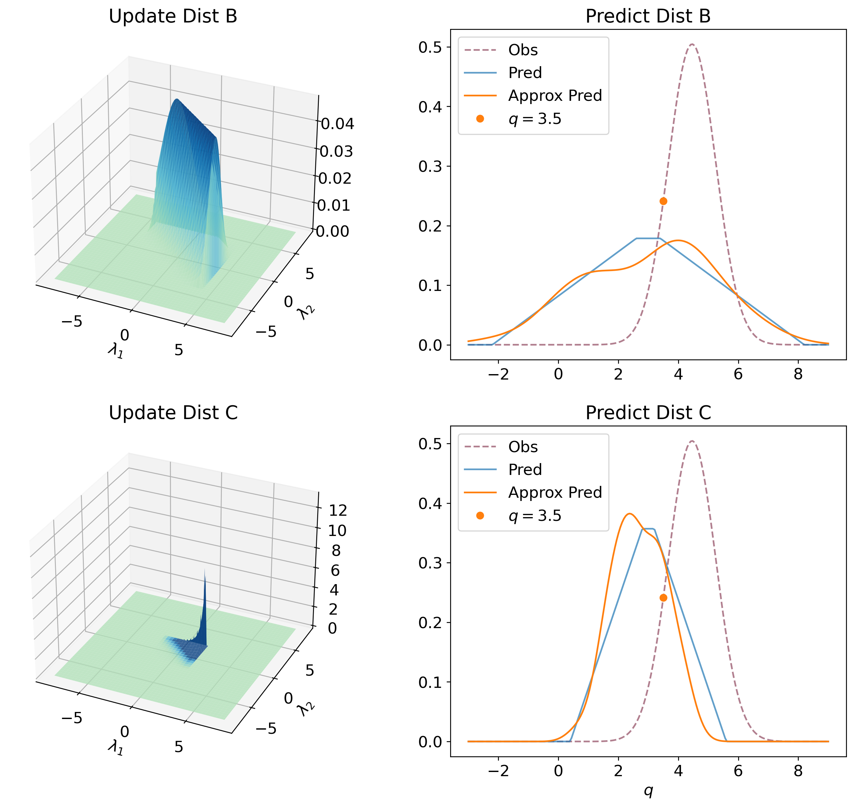


Data-consistent INVERSION (DCI)
$$Q(λ)$$
$$π_{update}\left(λ\right)=π_{init}\left(λ\right)\frac{π_{obs}(Q\left(λ\right))}{π_{predict}(Q\left(λ\right))}$$
The Predicted Density:
Determined or computed from the initial
Predictability assumption:
Stable w.r.t. approx. of predicted density (proven)
Note: most computational effort is determining predicted
$$∃C>0:π_{obs}\left(q\right)≤Cπ_{predict}\left(q\right), a.e. q∈D$$
Notes:
The predicted distribution is determined or computed from the initial density. It is the push-forward measure of the initial and is constructed by solving a forward UQ problem.
The initial needs to be chosen so that the predicted distribution satisfies the predictability. Essentially, what this means is that… FOR ANY DATA VALUE…
with positive probability of being observed, our model should also assign that data value with positive probability. We need to be able to predict what we observe.
For instance in the wobbly-plate example, we show the “update” determined using two different initial densities.
In the top row… the support of predict contains support of observed
In the bottom row… observe 6 to 8 with positive probability but we predict such observations with 0 probability
In practice, the predicted distribution is approximated... Previous work shows that predicted density is stable with respect to such approximations.
Most of the computational effort...

Slide 13
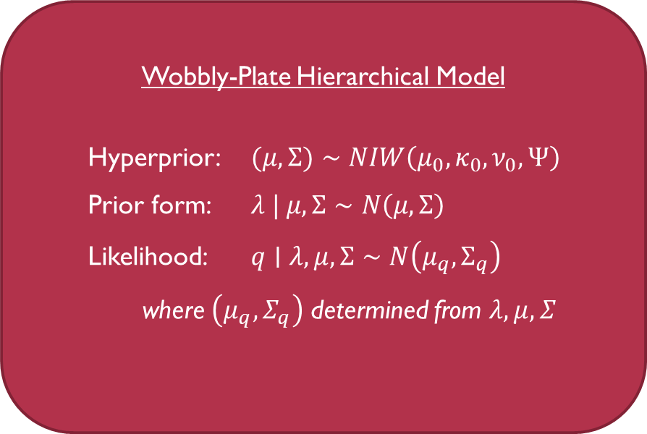
A Bayesian approach to the distribution problem
Hierarchical Model
Propose a prior parametric form of distribution with hyperparameters
Propose priors for the hyperparameters
Determine the likelihood of observations given prior
Use Bayesian inference to obtain posterior distribution
Estimate hyperparameters using MAP point
Measure uncertainty w/ posterior of hyperparameters
Wobbly-Plate Hierarchical Model
Hyperprior: $(μ,Σ)∼NIW\left(μ_{0},κ_{0},ν_{0},Ψ\right)$
Prior form: $λ | μ,Σ∼N\left(μ,Σ\right)$
Likelihood: $q∣λ,μ,Σ∼N\left(μ_{q},Σ_{q}\right)$
where $\left(μ_{q},Σ_{q}\right)$ determined from $λ,μ,Σ$
Notes:
We looked at the DCI… Now let’s look at a Bayesian approach.
The Bayesian approach to the distribution problem requires using a hierarchical model.
Propose a parametric form for the prior distribution with unknown hyper-parameters: for example…
We then propose a prior distribution for the hyperparameters: for instance….
Determine the likelihood of observations given our prior parameters and use Bayesian inference to obtain posterior distribution.
This gives us an estimate of the hyperparameters (from the MAP point) which we can use to determine the distribution of lambda that we are interested in
We can measure the uncertainty of our distribution of lambda by using the posterior distribution of our hyperparameters.

Slide 14
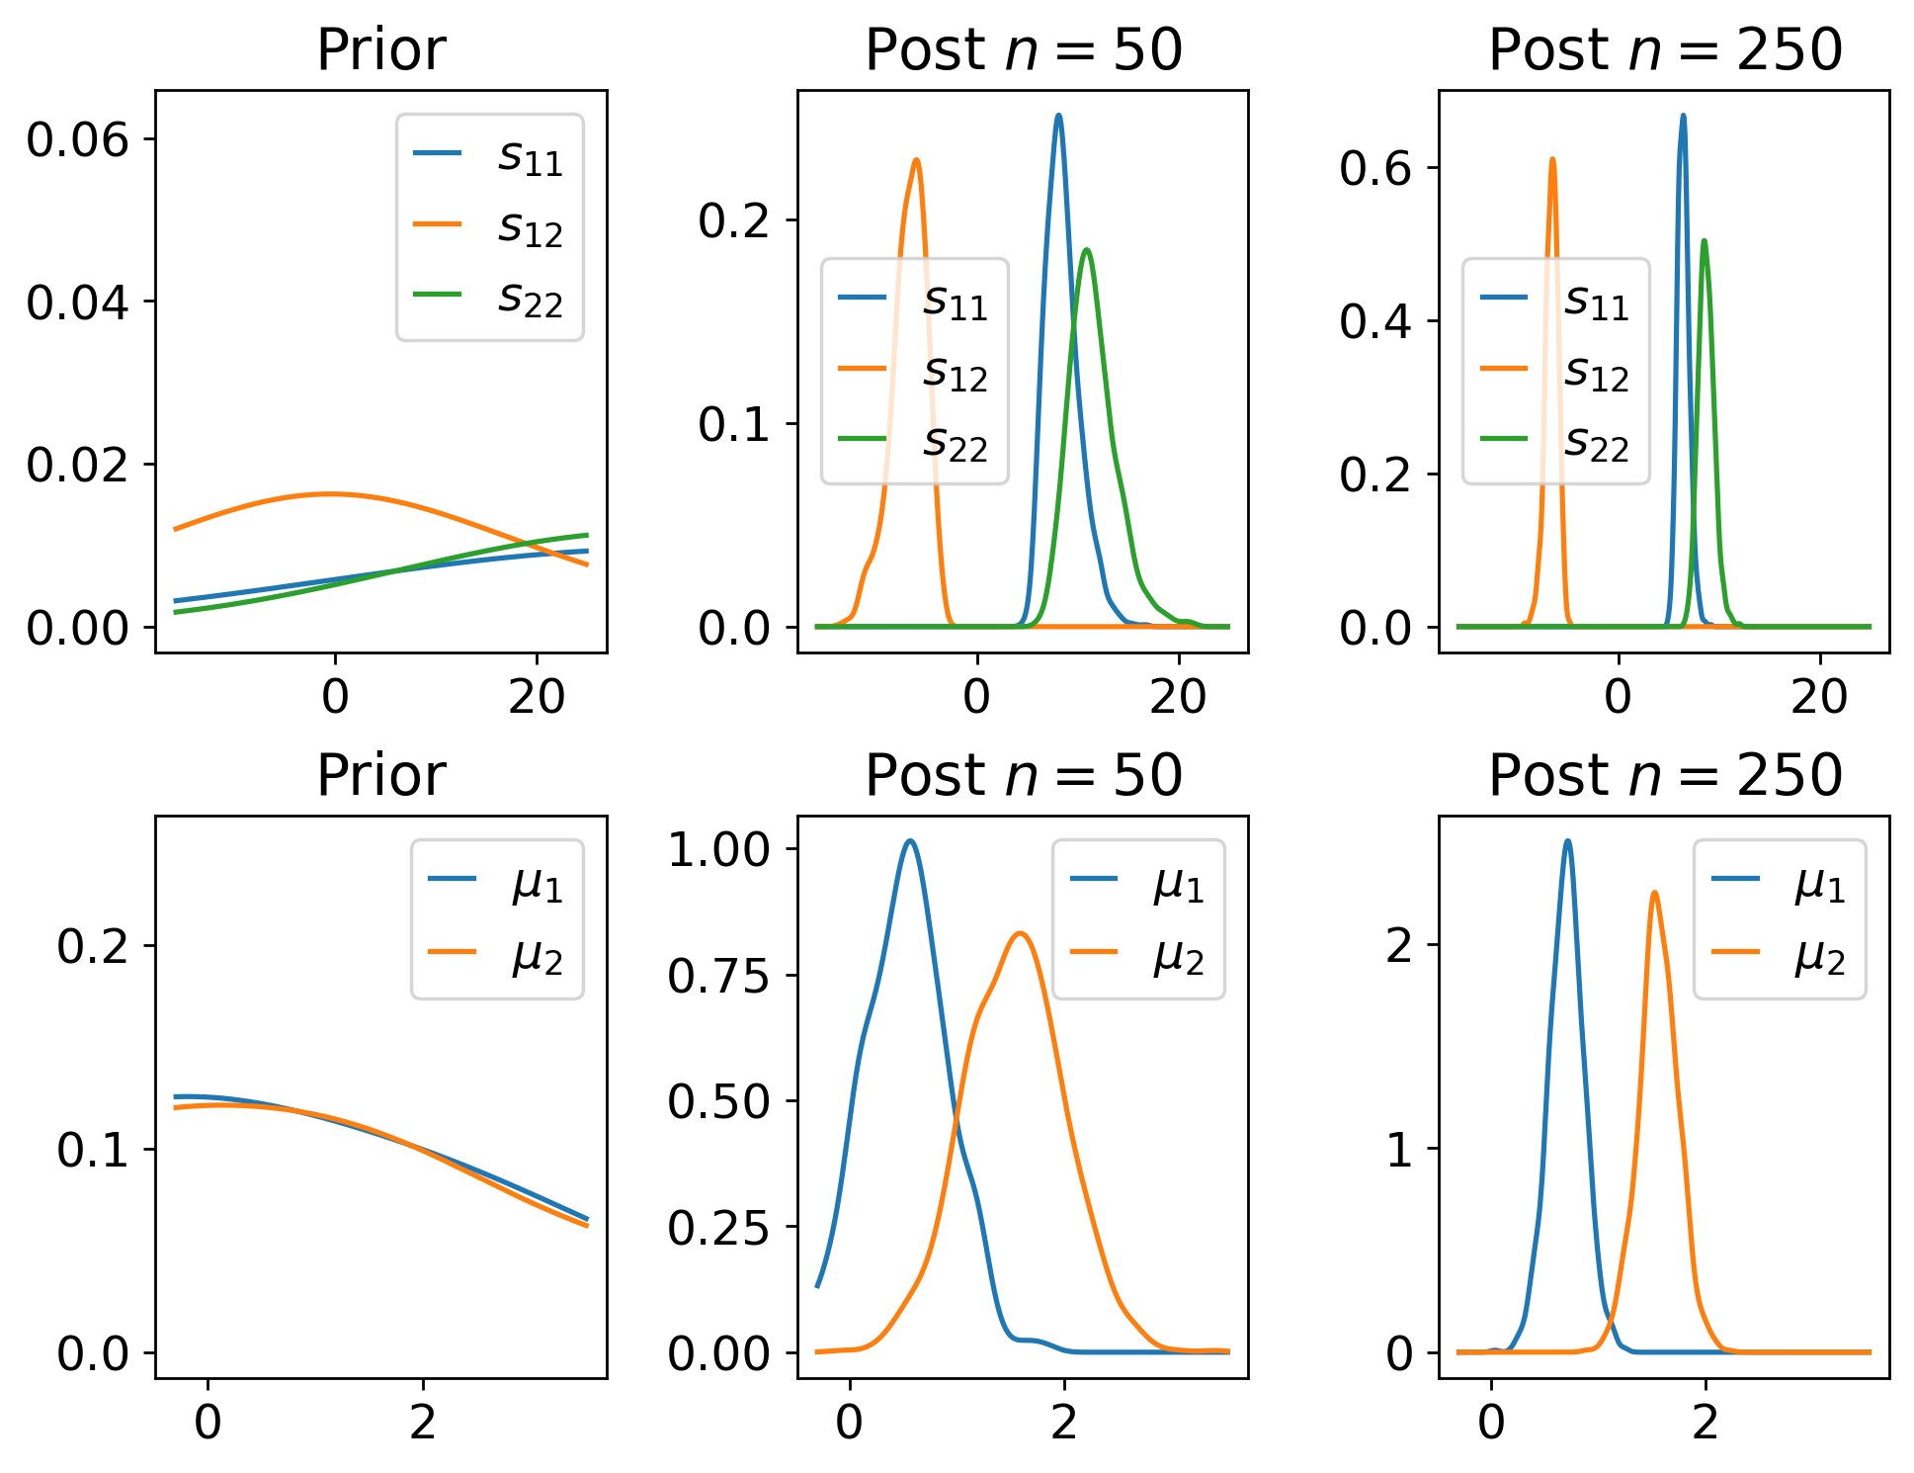
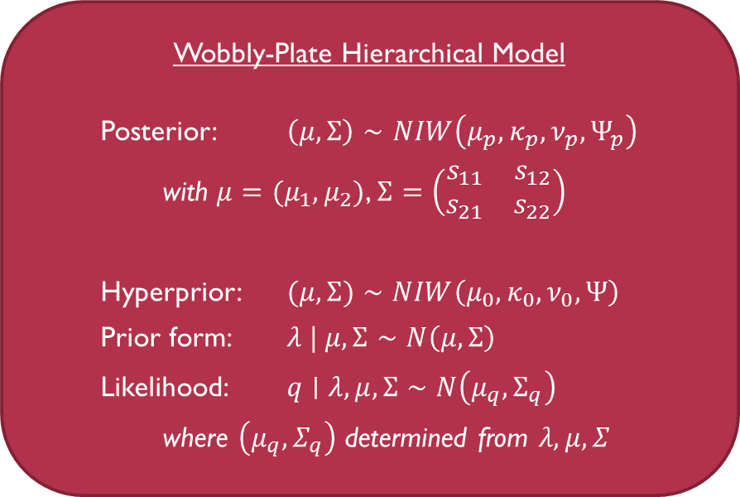
A Bayesian approach to the distribution problem
Wobbly-Plate Hierarchical Model
Posterior: $\left(μ,Σ\right)∼NIW\left(μ_{p},κ_{p},ν_{p},Ψ_{p}\right)$
with $μ=(μ_{1},μ_{2})$, $Σ=\left(\begin{matrix}s_{11} & s_{12} \\ s_{21} & s_{22}\end{matrix}\right)$
Hyperprior: $(μ,Σ)∼NIW\left(μ_{0},κ_{0},ν_{0},Ψ\right)$
Prior form: $λ | μ,Σ∼N\left(μ,Σ\right)$
Likelihood: $q∣λ,μ,Σ∼N\left(μ_{q},Σ_{q}\right)$
where $\left(μ_{q},Σ_{q}\right)$ determined from $λ,μ,Σ$
Notes:
For instance, here is what the posterior distribution of the hyperparameters (mu,Sigma) might look like.
Since the slope of the wobbly-plate is 2D, the average slope has two components (mu1,mu2). The covariance (i.e., how much the slope of the plate varies) will be a 2x2 symmetric matrix.
This figure on the left shows the prior and posterior distributions of each of these hyperparameter components.
We choose a prior that is fairly broad for each of the components.
As more observations are obtained, the uncertainty of these hyperparameter components are reduced and converge to the “MAP” or maximum-aposteriori estimates of the mean and covariance.

Slide 15
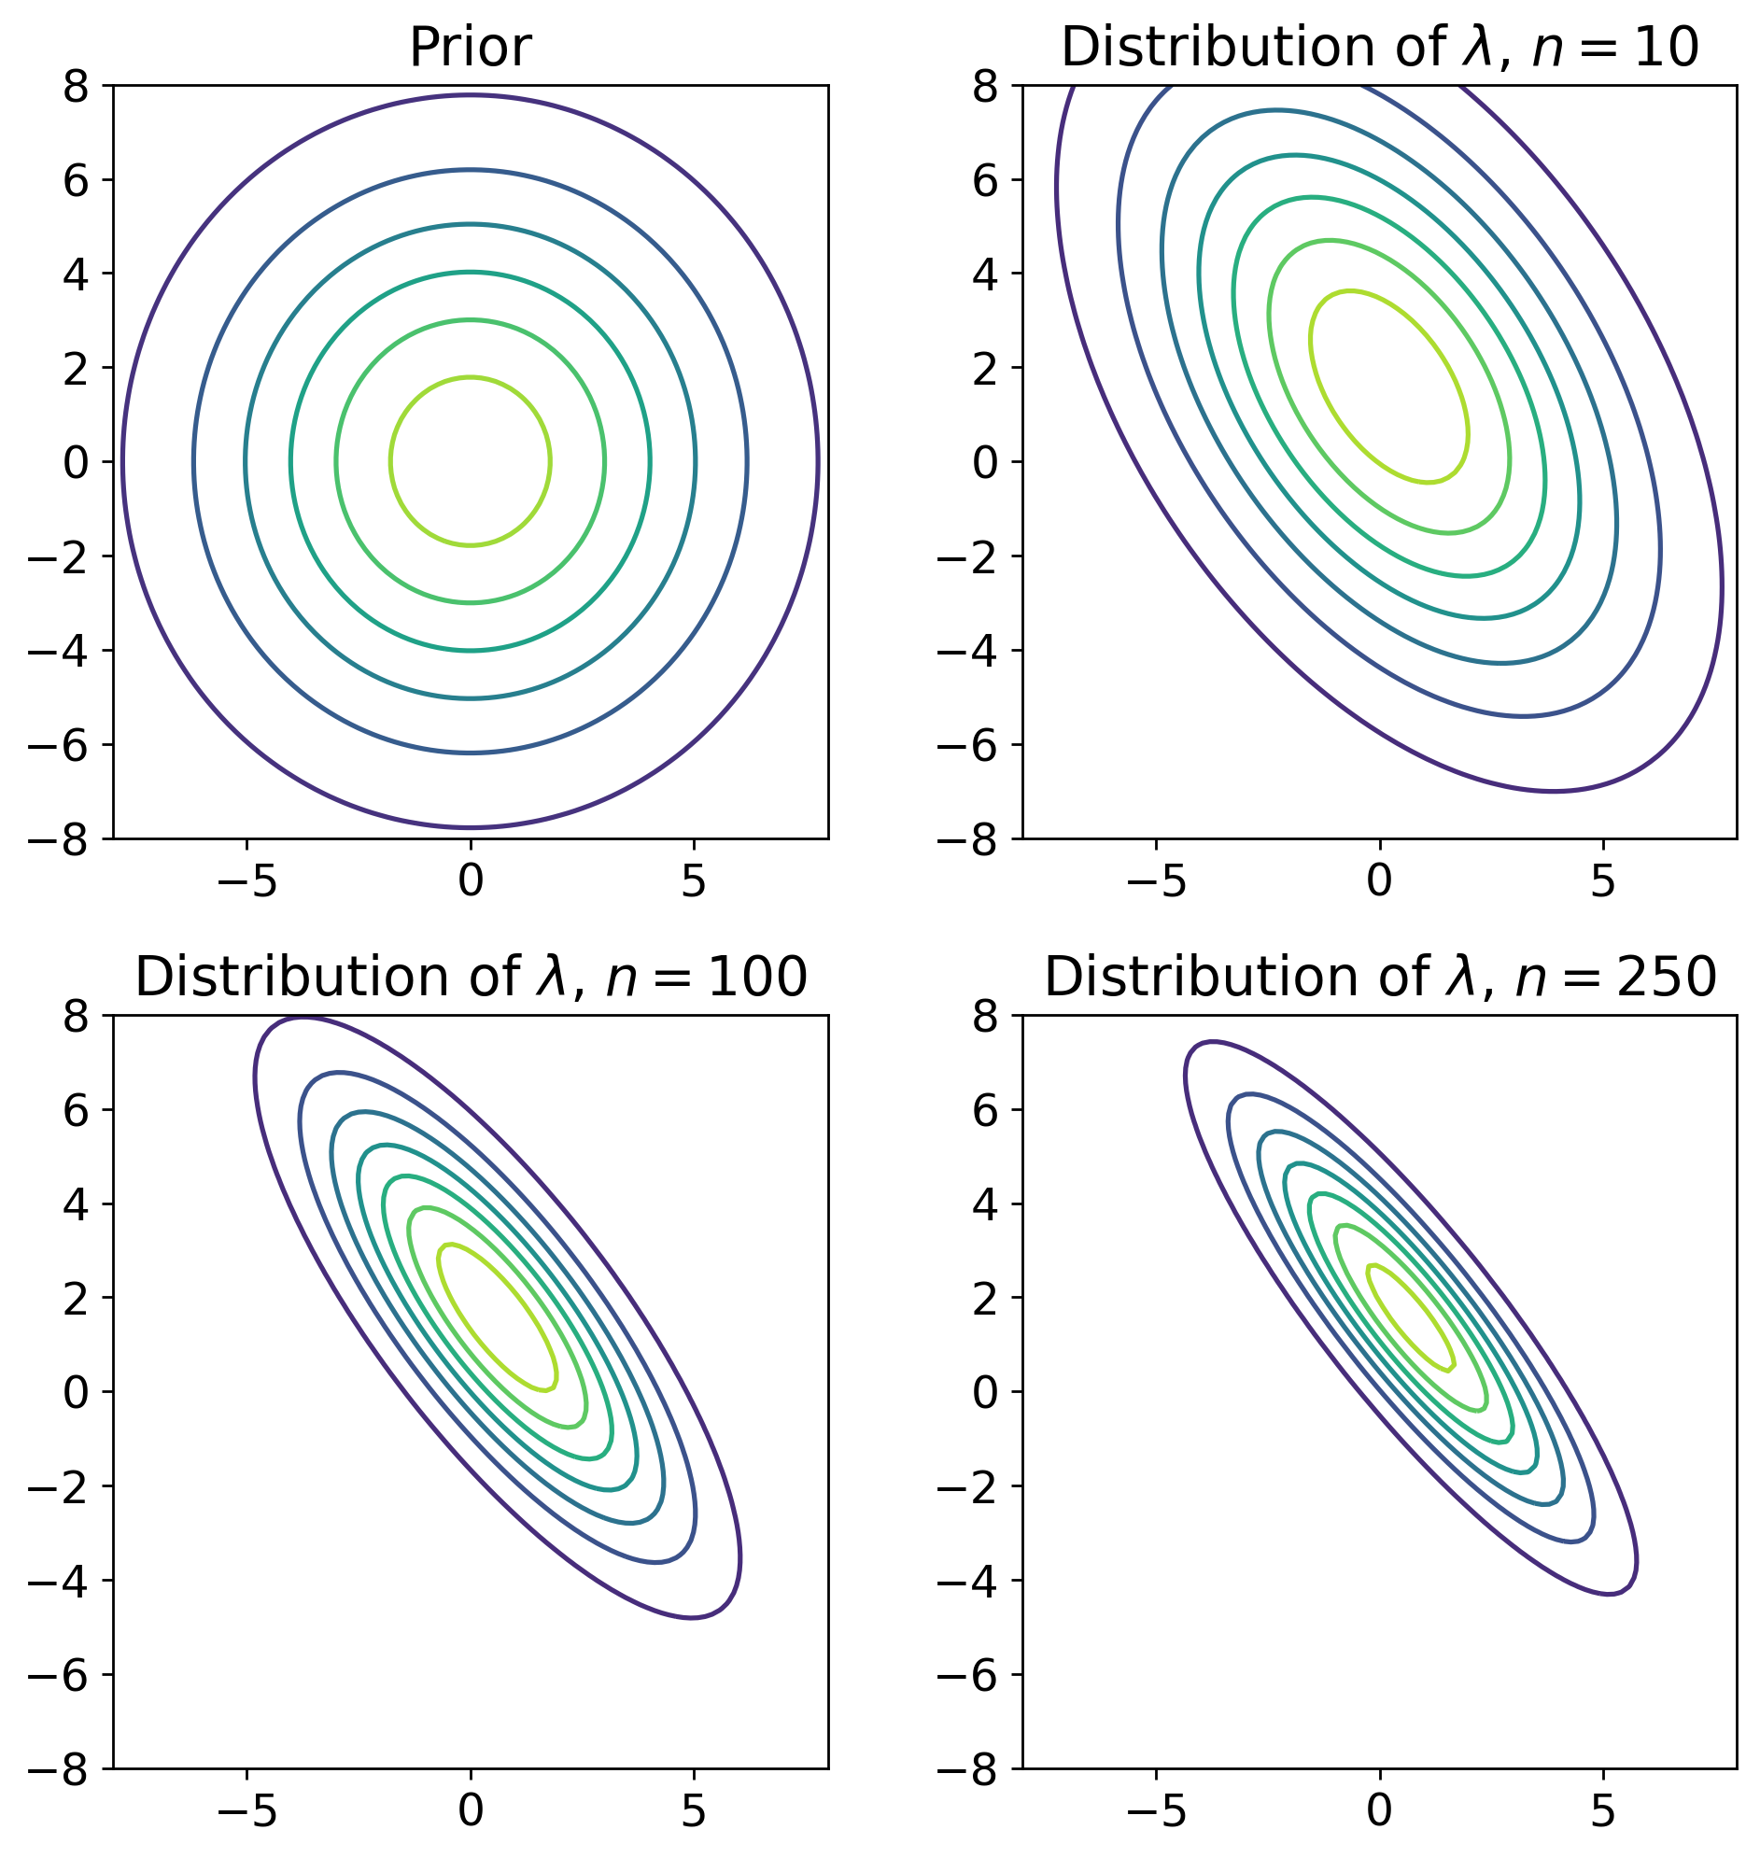
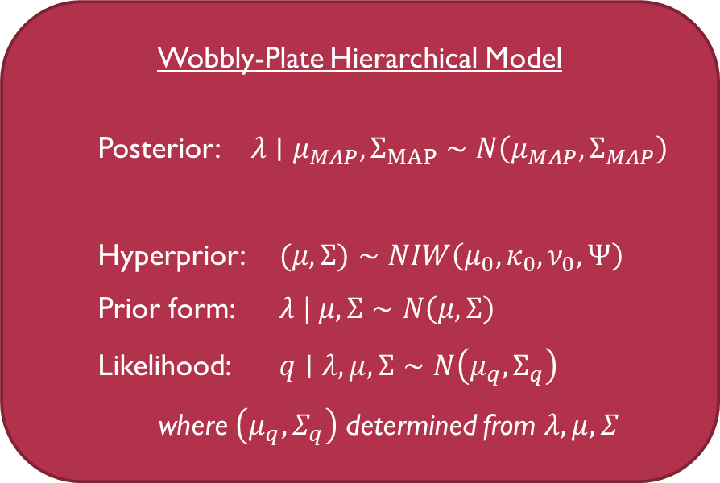
A Bayesian approach to the distribution problem
Wobbly-Plate Hierarchical Model
Posterior: $λ∣μ_{MAP},Σ_{MAP}∼N\left(μ_{MAP},Σ_{MAP}\right)$
Hyperprior: $(μ,Σ)∼NIW\left(μ_{0},κ_{0},ν_{0},Ψ\right)$
Prior form: $λ | μ,Σ∼N\left(μ,Σ\right)$
Likelihood: $q∣λ,μ,Σ∼N\left(μ_{q},Σ_{q}\right)$
where $\left(μ_{q},Σ_{q}\right)$ determined from $λ,μ,Σ$
Notes:
This shows plots of the distribution for the parameter of interest (the slope of the plate) using the MAP mean and covariance.
Notice that as the number of observations increases, the distribution of the parameter of interest converges towards a stable normal distribution with the appropriate mean and covariance.

Slide 16
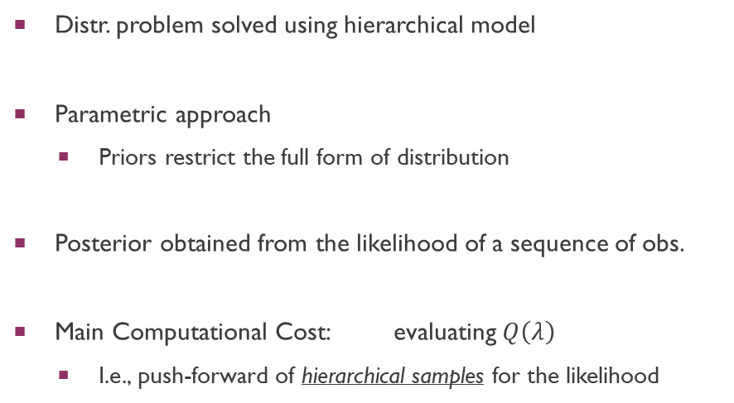
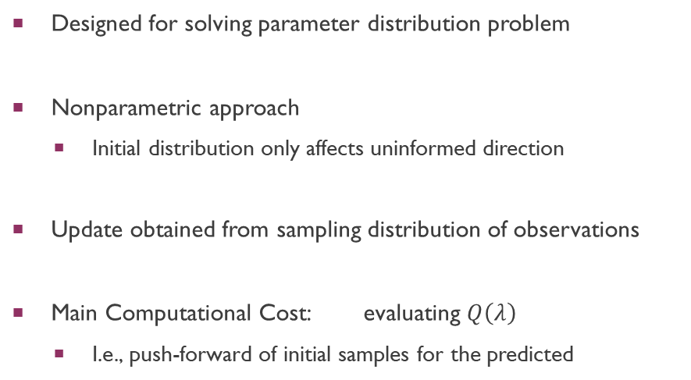
Comparison: parameter Distribution problem
Data-consistent Approach
Bayesian Approach
Designed for solving parameter distribution problem
Nonparametric approach
Initial distribution only affects uninformed direction
Update obtained from sampling distribution of observations
Main Computational Cost: evaluating $Q\left(λ\right)$
I.e., push-forward of initial samples for the predicted
Distr. problem solved using hierarchical model
Parametric approach
Priors restrict the full form of distribution
Posterior obtained from the likelihood of a sequence of obs.
Main Computational Cost: evaluating $Q\left(λ\right)$
I.e., push-forward of hierarchical samples for the likelihood
Notes:
Compare, compare, compare…
The main computational cost for both methods is generally in evaluating the model Q(lambda), like a large-scale wildfire model or a complex set of differential equations in an engineering system.
In DCI, we need to evaluate Q(lambda) to construct the predicted distribution.
In Bayesian approach, we need to evaluate Q(lambda) to determine the likelihood of the data.
Because the Bayesian approach to the distribution is hierarchical in nature, this can be particularly expensive since samples must be taken of the hyperparameters in addition to the parameter of interest.

Slide 17
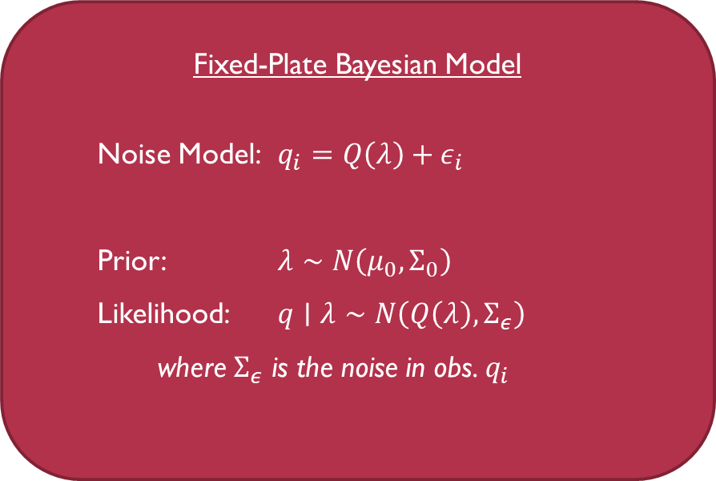
Bayesian approach: parameter estimation Problem
Bayesian method naturally solves estimation problem
Treat parameter of interest as a random variable
Propose prior and model the likelihood of obs.
Use Bayesian inference to obtain posterior distribution
Estimate parameter using MAP point
Measure uncertainty w/ posterior for parameter of interest
Fixed-Plate Bayesian Model
Noise Model: $q_{i}=Q\left(λ\right)+ε_{i}$
Prior: $λ∼N\left(μ_{0},Σ_{0}\right)$
Likelihood: $q∣λ∼N\left(Q\left(λ\right),Σ_{ε}\right)$
where $Σ_{ε}$ is the noise in obs. $q_{i}$
Notes:
Now lets look at the parameter estimation problem.
Recall that in this problem, there is some true slope of the plate, lambda, but it is subject to epistemic uncertainty.
For instance, there may be additional noise in the measurement instruments which we can model.
We want to estimate this fixed-slope of the plate, but also determine the uncertainty in our estimations using probability distributions.
The Bayesian approach naturally solves this parameter estimation problem.
We treat the parameter of interest as a random variable…

Slide 18
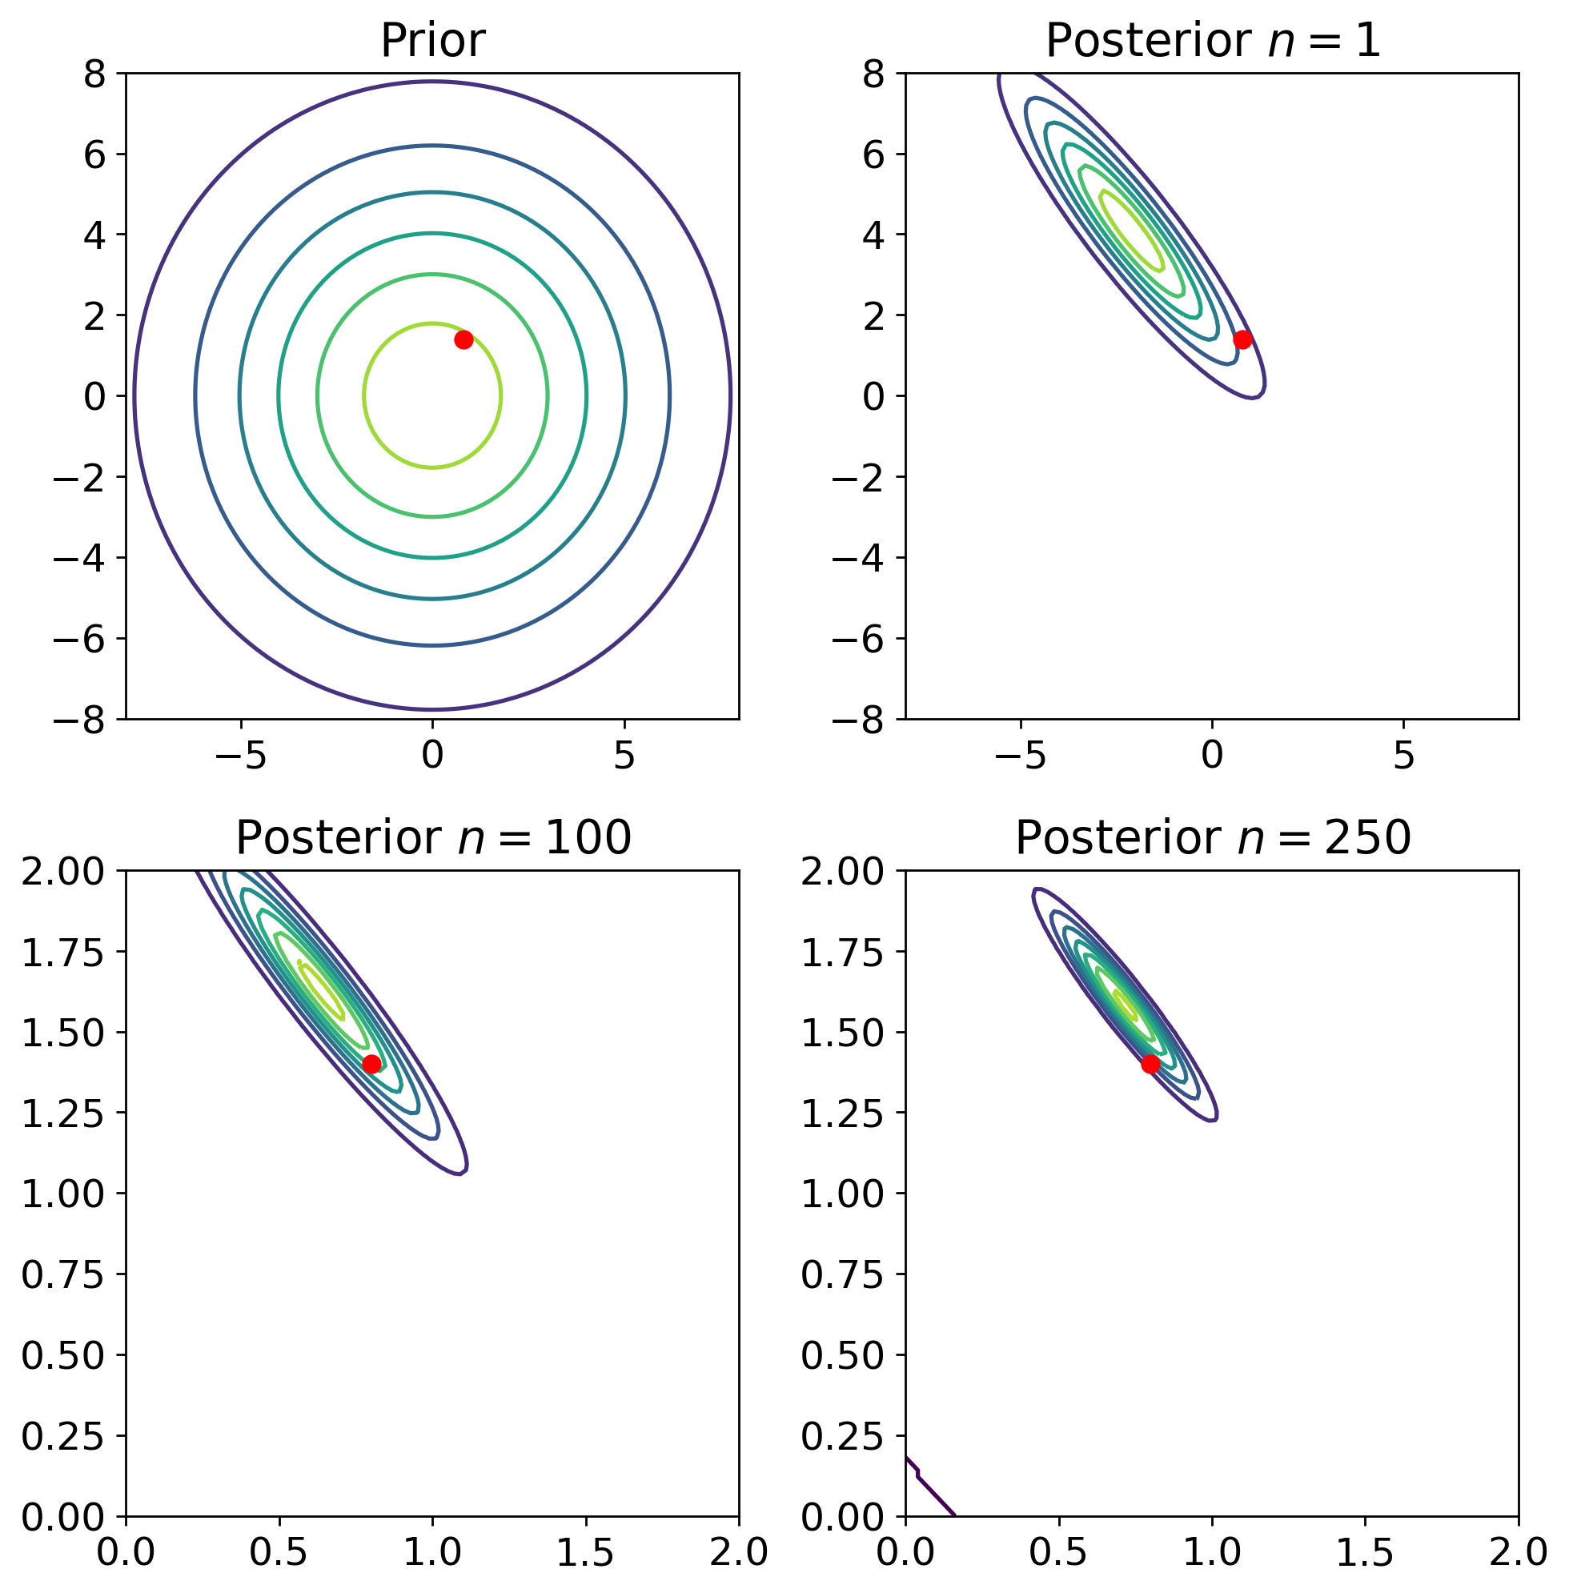
Bayesian approach: parameter estimation Problem
Fixed-Plate Bayesian Model
Noise Model: $q_{i}=Q\left(λ\right)+ε_{i}$
Prior: $λ∼N\left(μ_{0},Σ_{0}\right)$
Likelihood: $q∣λ∼N\left(Q\left(λ\right),Σ_{ε}\right)$
where $Σ_{ε}$ is the noise in obs. $q_{i}$
Notes:
Here we show plots of the posterior distribution for this model as n increases.
The red point is the true value of the fixed slope.
Notice that as the number of observations increases, the uncertainty in the posterior distribution decreases and the center of the posterior distribution (the MAP point) gets closer to the true value of the fixed slope.

Slide 19
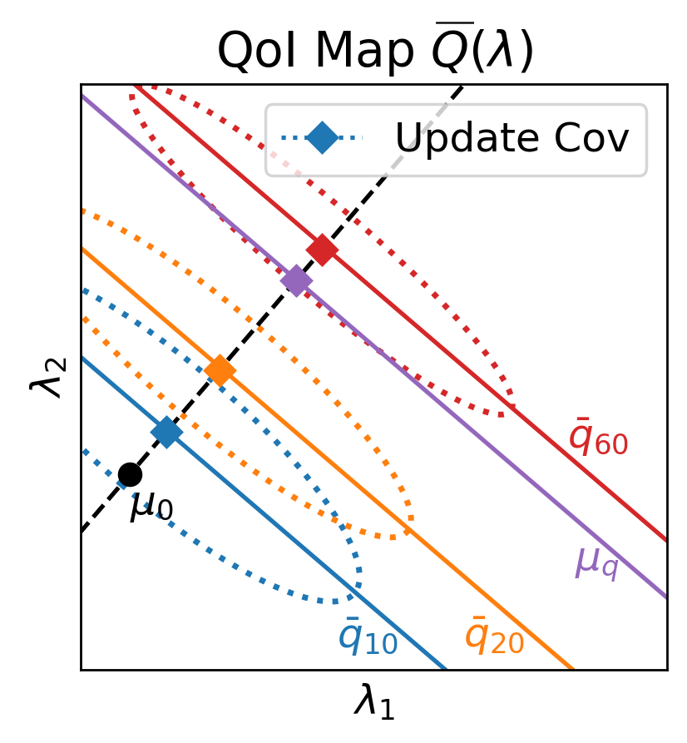

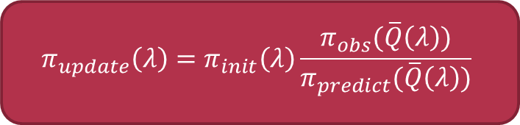
Data-consistent approach
$$π_{update}\left(λ\right)=π_{init}\left(λ\right)\frac{π_{obs}(\overline{Q}\left(λ\right))}{π_{predict}(\overline{Q}\left(λ\right))}$$
For Parameter Estimation:
Propose a new quantity of interest:
Treat parameter of interest as random variable
Apply DCI to this new QoI
$$\overline{q}=\overline{Q}\left(λ\right)=\frac{1}{n}\sum_{i=1}^{n}{Q\left(λ\right)}$$
Estimate obtained from the MUD point
Uncertainty determined from the update distr.
Notes:
Now let’s look at the DCI approach to the parameter estimation problem.
To apply DCI to parameter estimation, one thing we can do is to propose a new quantity of interest: instead of looking at individual observations (as the Bayesian case), we look at the distribution of sample means as the quantity of interest.
Similar to the Bayesian case, we treat the slope of the plate as a random variable.
Now we use the distribution of sample means (bar-q) as the observed distribution and determine the DCI update as before.
This produces updated densities which converge towards the true slope of the plate solution (as the sample mean converges to the true solution).
The MUD point can be used as the best estimate of the slope and the uncertainty can be measured using the updated probability distribution.

Slide 20
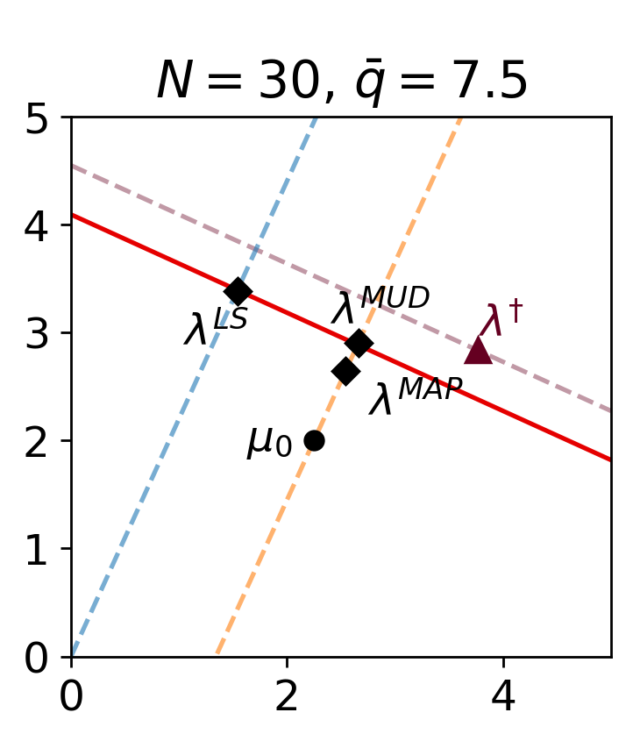
Comparison for parameter estimation
Bayesian approach:
Uses MAP point from posterior
Convex combination of prior and data
Prior “regularizes” least-squares
Data-consistent approach:
Uses MUD point from the update
Unbiased in data-informed directions
“Unregularizes” initial in certain dir.
Different Solutions to the Ill-posed Parameter Estimation Problem with Only One Sensor
Notes:
Let’s compare how the Bayesian and DCI parameter estimation are connected.
Consider the case where there is only one sensor (ill-posed)...
The true slope of the plate is denoted by lambda dagger.
We have a sample size of n=30 with a sample mean of qbar = 7.5.
The redline shows all of the possible values of the slope lambda where…
There are multiple possible solutions because the problem is ill-posed.
The (unbiased) least squares solution lies along this “data-mean contour”.
As the sample size increases, the RED LINE moves closer to the purple line, the “true solution contour”,
…and the least squares solution will move along the blue line towards the purple line and the true solution.
For the Bayesian approach:
mu0 is the prior mean.
The Bayesian MAP point is a biased estimate, so it does not lie on red line...
It is a convex combination of the data and the prior mean.
The bias “regularizes” the LS solution and to produce an estimate that is closer…
The MUD point:
Also uses mu0 as the “initial” mean to bias...
Unlike the MAP point, the MUD point is only biased in one direction
It is unbiased in the data-informed direction.
Thus the MUD point lies along the “data-mean contour” (like LS)
but uses the initial mean mu0 to select a solution along… that is closer...
This is cool because…

Slide 21
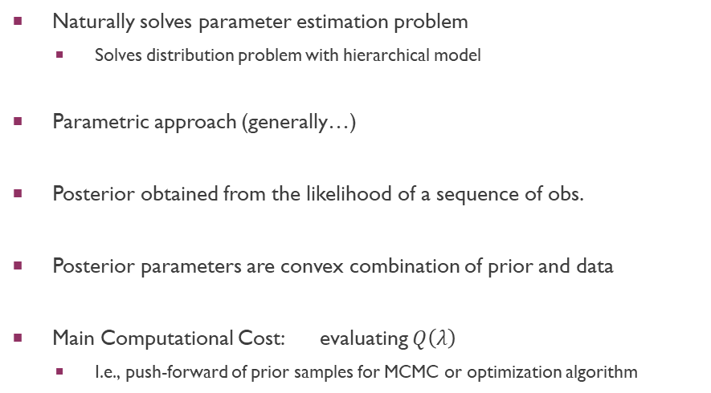
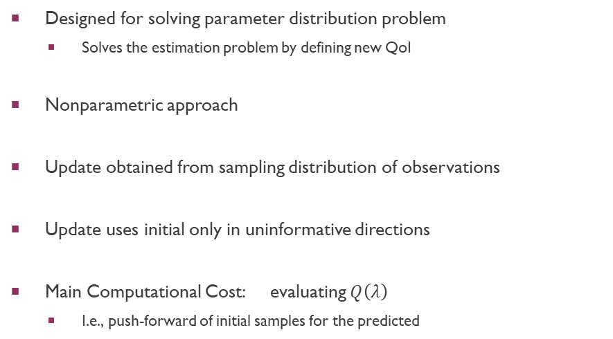
Summary
Data-consistent Approach
Bayesian Approach
Designed for solving parameter distribution problem
Solves the estimation problem by defining new QoI
Nonparametric approach
Update obtained from sampling distribution of observations
Update uses initial only in uninformative directions
Main Computational Cost: evaluating $Q\left(λ\right)$
I.e., push-forward of initial samples for the predicted
Naturally solves parameter estimation problem
Solves distribution problem with hierarchical model
Parametric approach (generally…)
Posterior obtained from the likelihood of a sequence of obs.
Posterior parameters are convex combination of prior and data
Main Computational Cost: evaluating $Q\left(λ\right)$
I.e., push-forward of prior samples for MCMC or optimization algorithm
Differ in handling of ill-posed inverse problems!

Slide 22
Overall Goal & Outline
Goal: The data-consistent (DCI) approach is a flexible and robust framework for solving inverse problems
Comparative Analysis (DCI handles different ill-posed inverse problems, differs from other methods)
Extension to Stochastic Maps
Consequences of Finite Data

Slide 23
Combinations of uncertainty: Stochastic maps
Typical for both aleotoric and epistemic uncertainties to influence observations
E.g., wobbly-plate with additional measurement noise
Extension of DCI to stochastic maps:
Published peer-reviewed paper in Inverse Problems^{1.}
Contribution: Broadens the applicability of DCI to a wide range of complex inverse problems
1. Butler T, Wildey T, Yen TY (2020). “Data-consistent inversion for stochastic input-to-output maps.” Inverse Problems, 36(8), 85015. doi:10.1088/1361-6420/ab8f83
Notes:
It is typical…
When we have this combination of both types of uncertainty, the inverse problem can be described in terms of a stochastic map Q.
Previous research focused only on deterministic models Q.
In my dissertation research, I provided an extension to DCI for stochastic maps. This research published in Inverse problems and its major contribution is that…

Slide 24
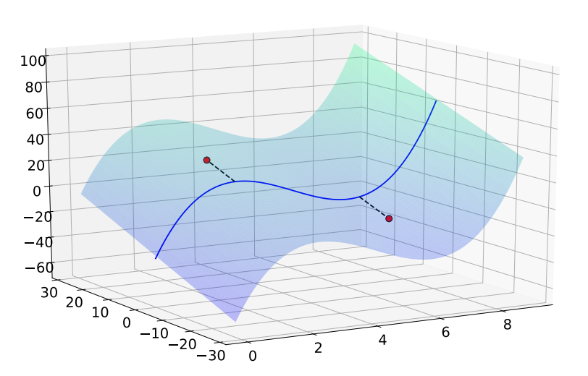
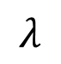
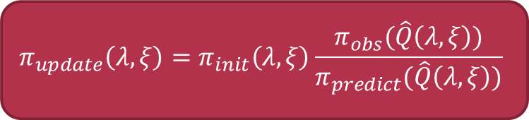
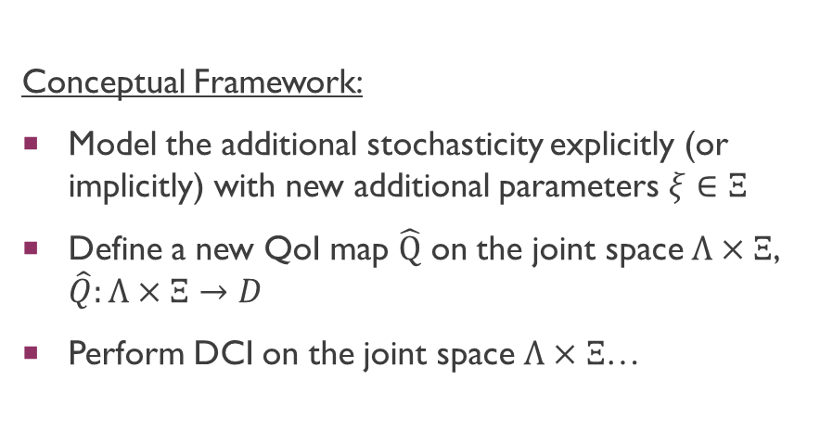

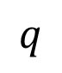
Extension of dci: stochastic maps
$$π_{update}\left(λ,ξ\right)=π_{init}\left(λ,ξ\right)\frac{π_{obs}(\hat{Q}\left(λ,ξ\right))}{π_{predict}(\hat{Q}\left(λ,ξ\right))}$$
Conceptual Framework:
Model the additional stochasticity explicitly (or implicitly) with new additional parameters $ξ∈Ξ$
Define a new QoI map $\hat{Q}$ on the joint space $Λ×Ξ$, $\hat{Q}:Λ×Ξ→D$
Perform DCI on the joint space $Λ×Ξ$…
$$q$$
$$ξ$$
$$λ$$
Notes:
In brief, the conceptual framework for this extension can be thought of as follows:
First, we model the additional stochasticity….
Then we define a new deterministic QoI map on the joint space of our parameter of interest (lambda) and the new noise parameters (xi).
For any point (lambda,xi), we can now predict the value of the observed data q.
Once we have done this, we can use DCI on the joint space using a proposed initial, computing the predicted, and comparing it to the observed density as we have seen previously.

Slide 25
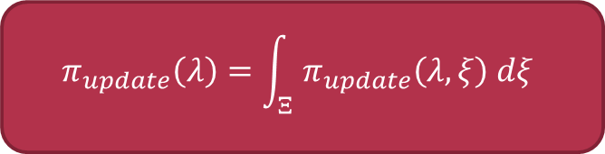
Summarized Theoretical results
Given that the joint initial satisfies predictability assumption…
The joint update exists and is unique
The joint update is stable w.r.t. perturbations in any of its component distributions (initial, predicted, observed)
We show that these properties also apply to the marginal distribution (details in dissertation)…
$$π_{update}\left(λ\right)=\int_{Ξ}^{ }{ π_{update}\left(λ,ξ\right) dξ}$$
Notes:
Given that the joint initial distribution over (lambda,xi) satisfies the predictability assumption, we can show that…
However, at the end of the day, we are interested in the probability distribution for lambda (not the joint distribution).
In our work, we show that these properties also apply to the marginal distribution as well!

Slide 26
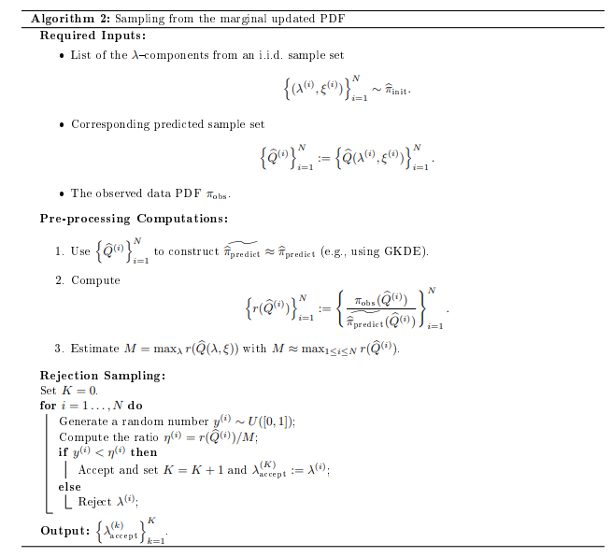
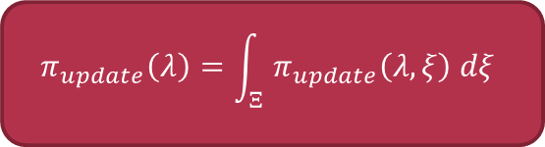
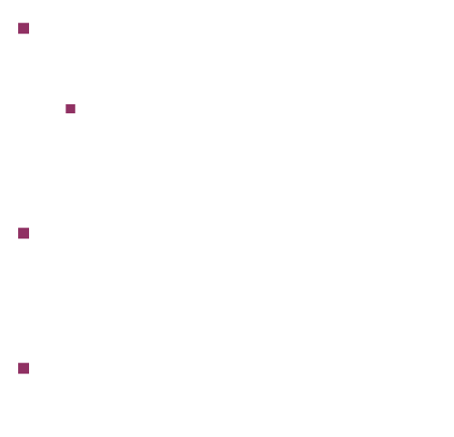
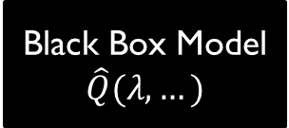
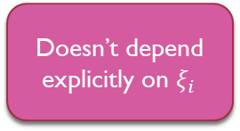
Sampling from the marginal
Black Box Model
$$\hat{Q}(λ,…)$$
$$π_{update}\left(λ\right)=\int_{Ξ}^{ }{ π_{update}\left(λ,ξ\right) dξ}$$
(e.g. large-scale weather models…)
In practice: sample from the marginal rather than integrate
Sample from the joint $⇒$ sample from the marginal
Algorithm 2 allows implicit modeling of stochasticity…
Predictability assumption implies that $E\left(r\right)=1$
Doesn’t depend explicitly on $ξ_{i}$
Notes:
So in theory… However, this is quite difficult to do in practice.
Instead, it is much more practical to obtain a sample from the marginal…
This can be done using rejection sampling… (Algorithm 2)
I want to highlight a few things.
First, this algorithm allows implicit modeling of the additional stochasticity...
This is an extremely useful feature:
This means that if we have some large-scale black box model that is modeling the stochasticity in ways that are inaccessible to the users, we can still apply our algorithm.
We provide the appropriate inputs lambda, let the model handle the stochastic terms implicitly, and obtain the output quantities of interest.
Using these lambda and computed q values, we can obtain the update sample.
Finally, I want to point out one useful diagnostic tool that we can use to check that our model is valid (in the sense that it satisfies the predictability assumption).
The data-consistent “ratio”, which we often denote as “r” is defined as the observed/predicted…E(r)=1… We will see how this fact is useful a little later.

Slide 27
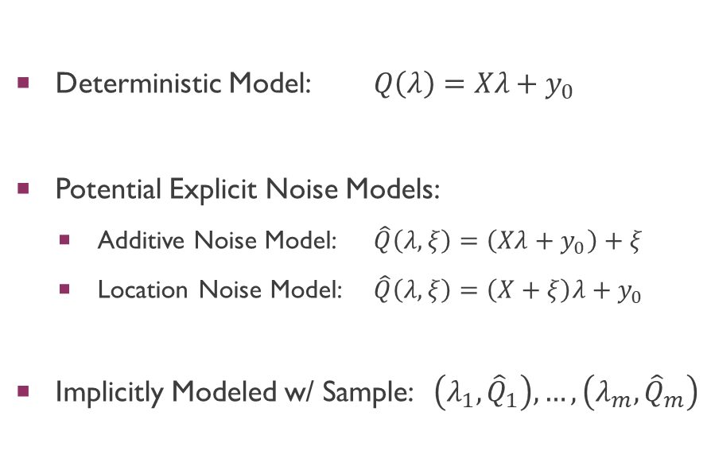
Wobbly-plate example revisited
Deterministic Model: $Q\left(λ\right)=Xλ+y_{0}$
Potential Explicit Noise Models:
Additive Noise Model: $\hat{Q}\left(λ,ξ\right)=\left(Xλ+y_{0}\right)+ξ$
Location Noise Model: $\hat{Q}\left(λ,ξ\right)=\left(X+ξ\right)λ+y_{0}$
Implicitly Modeled w/ Sample: $\left(λ_{1},{\hat{Q}}_{1}\right),…,\left(λ_{m},{\hat{Q}}_{m}\right)$
Notes:
The wobbly-plate example was actually inspired by tiltmeters: measurement devices that are used to measure erosion and volcanic activity.
In practical applications, these devices are likely to return measurements confounded by noise and errors that are not controllable.
Maybe they’re mis-deployed or mis-calibrated, or are perturbed by other natural phenomena.
We illustrate how these stochastic elements can be taken into account…
Here is the deterministic model of Q… when both sensors are functioning…
X, lambda, y0 represents…
This model outputs predicted heights of the measurements at each location.
In the DCI approach, we can model the additional stochasticity explicitly in different ways depending on how we believe noise is affecting our measurement instruments.
Model the noise with the common additive noise model…
Propose a location noise model…which then influences the output heights.
Modeled implicitly as long as we have a sample of input slopes and their corresponding output height values.

Slide 28
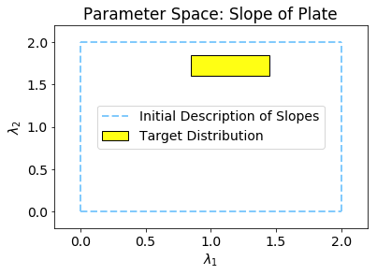
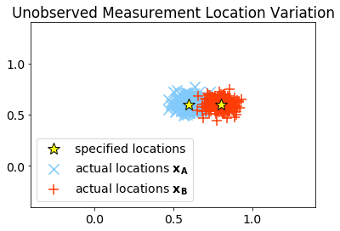
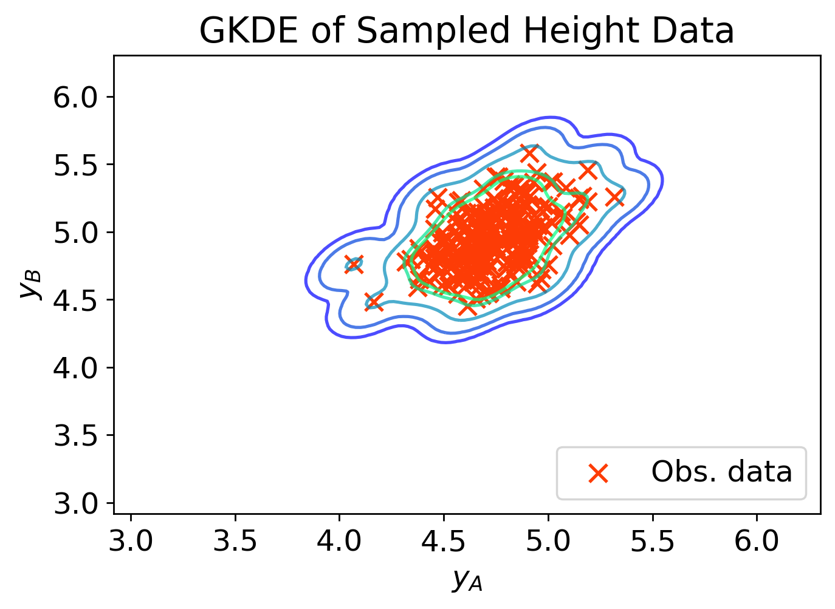
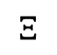
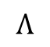
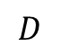
Target distribution: Simulated data
Data generated from a system subject to location noise
$$Λ$$
$$Ξ$$
$$D$$
Notes:
In our scenario, we will simulate data generated from a system using a location noise model.
Here we assume that the slopes of the wobbly-plate lie within this range of values in the yellow box. This is our target distribution of our parameter of interest.
The locations of the measurement devices will be centered at these two points but are subject to random variation.
Using the location noise model described above, we generate the observed height data shown in the last figure.
From this data, we construct the observed probability density using a GKDE.
We only see what is given in the data space, the observations of the heights. We want to use this to infer the distribution of the slopes of the wobbly-plate given the additional stochastic uncertainty in the system.

Slide 29
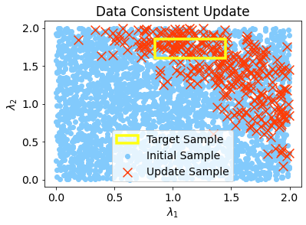




Data-consistent solution
Implicit noise model with rejection sampling
Update reflects the uncertainty due to the stochastic location noise (note: inverse problem ill-posed with noise)
Black Box Model
$$\hat{Q}(λ,…)$$
$$Λ$$
$$D$$
Notes:
Here we show what this might look like using an implicit noise model with rejection sampling (as in Algorithm 2).
The blue dots are the initial sample of possible slopes which we use to construct the predicted sample by evaluating Q(lambda) in a black box model that implicitly incorporates the stochastic noise.
We then use the data-consistent ratio to compare the observed data to the predicted data and obtain the updated sample shown in red.
Notice that the variability in the updated sample is greatly reduced to a region containing the target sample, but also contains additional possible values outside of the target sample of slopes.
The update sample appropriately reflects the uncertainty due to the influence of additional unknown noise in the locations (in other words, the inverse problem was ill-posed, so we would not expect to reconstruct the target sample exactly).

Slide 30




Evaluating insufficient predictive models
Filter out inadequate models using diagnostic of average “r”
$\overline{r}≈1⇒$ predictability assumption satisfied
$\overline{r}≉1⇒$ predictability assumption not satisfied
Different Model
$$\hat{Q}(λ,…)$$
Black Box Model
$$\hat{Q}(λ,…)$$
$$Λ$$
$$D$$
Notes:
Another nice feature of the DC approach is it allows to filter out and identify scenarios where our stochastic model is inadequate or insufficient to capture the data.
This is where we will use the diagnostic of the average “r” value.
Recall that we said that if the predictability assumption is satisfied, then the average value of r should be about 1.
This tells us that our model is sufficient to predict the data.
On the other hand, if the average r value is not close to one, we should be concerned about whether the predictability assumption is satisfied, and should consider whether our model is inadequate.
For instance, in our previous black-box model, the computed r value was 0.997, which is close enough to 1 that we shouldn’t be concerned about the predictability assumption.
On the other hand, consider a different black-box model using the same initial sample. Here, the average r-value is only 0.892 and we can see in the plot that a portion of the observed data values seem to fall in a region of very low predicted probability.
These assessments tell us that this new black-box model may be inadequate to predict the data, even without knowing the specific form of the model itself.

Slide 31
Summary
Developed extension of DCI to stochastic map:
Contribution: Broadens the applicability of DCI to a wide range of complex inverse problems
Extension to DCI is flexible:
Explicitly model and analyze combinations of stochastic uncertainties, including nonlinear embeddings
Implicitly model the stochastic uncertainties when computational model is complex
Predictability assumption provides diagnostic for assessing sufficiency of stochastic model (average “r”)
Extension to DCI is robust:
Theoretical guarantees from DCI apply to marginal updated distribution
Consistency: marginal updated sample is consistent with the observed sample
Notes:
Develop…
Extension…
**And I should note that we have demonstrated these features using more complex applications involving partial differential equations with uncertain diffusion, but I’ve omitted that example here for brevity and clarity.
Extension to DCI is robust…

Slide 32
Overall Goal & Outline
Goal: The data-consistent (DCI) approach is a flexible and robust framework for solving inverse problems
Comparative Analysis (DCI handles different ill-posed inverse problems, differs from other methods)
Extension to Stochastic Maps (DCI offers flexible modeling of stochastic uncertainty, guarantees consistency)
Consequences of Finite Data

Slide 33

Consequences of finite data
$${\tilde{π}}_{update}\left(λ\right)=π_{init}\left(λ\right)\frac{{\tilde{π}}_{obs}(Q\left(λ\right))}{π_{predict}(Q\left(λ\right))}$$
Observed distribution must be approx. from finite data
Many different methods for density estimation…
How do such approx. affect the DCI update?
Contributions:
Extend convergence results w.r.t. observed distribution to different metrics
Quantify uncertainty of update due to finite approx.
Illustrate practical considerations and principles with kernel density estimates and Dirichlet Process
Notes:
Sometimes observed is given…
Different methods…
We know it is stable (previous research)…
How do approximations…?
Contributions…
We extend…
We show how to…
Illustrate…

Slide 34




Convergence results for DCI
Previous research in $L_{1}$-norm (total variation metric): approx. error of update = approx. error of observed
Density estimation methods use different norms to prove convergence
E.g., kernel density estimates (KDE) often use $L_{2}$-norm
$⇒$ Show convergence of update w.r.t. observed in $L_{p}$-norm
The update and observed are densities over two different spaces ($Λ$ vs. $D$)
Distances between their measures may require different metrics over two spaces
$⇒$ Use integral probability metrics to provide general conditions for convergence and equality of measures
$${\left\|{\tilde{π}}_{up}−π_{up}\right\|}_{L_{1}\left(Λ\right)}={\left\|{\tilde{π}}_{obs}−π_{obs}\right\|}_{L_{1}\left(D\right)}$$
$${\left\|{\tilde{π}}_{up}−π_{up}\right\|}_{L_{p}\left(Λ\right)}≤C{\left\|{\tilde{π}}_{obs}−π_{obs}\right\|}_{L_{p}\left(D\right)}$$
$$d_{ℱ_{Λ}}\left({\tilde{ℙ}}_{up},ℙ_{up}\right)≤d_{ℱ_{D}}\left({\tilde{ℙ}}_{obs},ℙ_{obs}\right)$$
Notes:
Start with convergence results…
Previously…
However different DE techniques…
For instance…
We show that if obs converges in Lp => up converges in Lp
Furthermore…
Distances…
Use IPM to provide…
Details of these results in dissertation.

Slide 35


Impact of results for future research
Theoretical basis for analyzing converge of update w.r.t. different density estimation methods used for observed
E.g., $L_{2}$-convergence of GKDE in data space $⇒$ $L_{2}$-convergence of update in parameter space at a similar rate
Results with integral probability metrics (IPM) useful for density estimation with Generative Adversarial Networks (GANs)
Notes:
Want to show some of the impact of these results for future research…

Slide 36

uncertainty of update due to finite sampling
Convergence: more data $⇒$ better ${\tilde{π}}_{obs}$ $⇒$ better ${\tilde{π}}_{update}$
What is the variability of the update given a dataset? What is the uncertainty of the update due to finite sampling?
For density estimation of observed: use Confidence or Credible Intervals (CI)
$⇒$ Show how to use the CI for the observed to obtain CI for the update
Two nonparametric density estimation methods: GKDE and Dirichlet Process
$⇒$ Illustrate practical considerations and perform UQ of update (using CI) for each method
$⇒$ Highlight some extra benefits of using Dirichlet Process mixture model for analyzing the update
Notes:
So far, we showed convergence results for DCI.
These results show that as more data is observed and obs density converges, we get a better update.
While this is nice in theory, our second question is concerned with practical estimates of uncertainty.
When you obtain a sample of data, you just have that sample…
What is variability of update given a sample?
This question is typically answered for DE of obs using…
We show…
Specifically, we will illustrate how to do this using two different methods…

Slide 37




Example: Density estimation in one-dimension
Dataset of $n=250$ observations of $q$
Data generated from “tri-peak” density
Compare:
Gaussian Kernel Density Estimate (GKDE)
Dirichlet Process Mixture Model (DPMM)
Notes:
That’s where we’re headed.
Let’s start by just talking / reviewing density estimation techniques for the observed density in the data space.
For this example, we simulated 250 observations of q in data space.
Histogram and boxplot of data is shown in figures here
Data generated from…
Compare GKDE and DPMM

Slide 38





Gaussian KDE vs. Dirichlet process mixture model
$${\tilde{π}}_{obs}\left(q\right)=\frac{1}{n}\sum_{i=1}^{n}{f_{N\left(0,h\right)}\left(q−q_{i}\right)}$$
$${\tilde{π}}_{obs}\left(q\right)=\sum_{k=1}^{∞}{w_{k} f_{N\left(μ_{k},σ_{k}\right)}\left(q\right)}$$
GKDE
DPMM
As # obs. increases, GKDE converges to target
Gaussian centered at each data point
Infinite mixture of Gaussian distributions
Bayesian inference used to obtain posterior from data
Notes:
Here’s a brief review of how these two methods work…
Let’s start with GKDE.
A GKDE fits a normal density with a “bin width” or “bandwidth” at each data point
These kernels are averaged together to produce the GKDE
As n increases…
On the other hand, a DPMM uses an infinite mixture of normal.
These normal(s) are not centered at data points
But at unknown means mu_k with unknown widths determined by…
This infinite sum of normal is weighted by wk which decay to zero so that…
We use Bayesian inference to determine the means, std dev, and weights
This leads to a finite number of posterior components with nonzero weight

Slide 39




Non-parametric estimates depend on hyperparameters
$${\tilde{π}}_{obs}\left(q\right)=\frac{1}{n}\sum_{i=1}^{n}{f_{N\left(0,h\right)}\left(q−q_{i}\right)}$$
$${\tilde{π}}_{obs}\left(q\right)=\sum_{k=1}^{∞}{w_{k} f_{N\left(μ_{k},σ_{k}\right)}\left(q\right)}$$
GKDE
DPMM
Sensitive to choice of bandwidth $h$
Sensitive to choice of prior hyperparameters
Prior Mixture Hyperparameters
Weights: $w_{k}=β_{k}\prod_{j=1}^{k−1}{\left(1−β_{j}\right)}$
$β_{k}∼Beta(1,α)$
Components:
$∀k$: $(μ_{k},σ_{k}^{2})∼NIW\left(μ_{0},κ_{0},ν_{0},Ψ\right)$
similar role to bandwidth
Accuracy of ${\tilde{π}}_{obs}$ directly impacts ${\tilde{π}}_{up}$: choice of these hyperparameters matter!
Notes:
A few notes about the practical considerations of implementing these DE techniques…
GKDE is sensitive…
Using a typical rule of thumb like Scott’s rule may lead to over-smoothing…
(as shown by the blue curve)
If bandwidth chosen optimally using MISE, we obtain a better overall estimate
But it is subject to more variability (may undersmooth or overfit).
On the other hand…
We use Bayesian inference which relies on prior distributions for…
The values used to define these prior distributions may influence the DE
Specifically…
The point here is that these implementation choices matter…
They matter because…

Slide 40




UQ for the observed: determining CI
Bootstrap KDEs:
$${\left\{q_{i}\right\}}^{1},…,{\left\{q_{i}\right\}}^{M}⇒{\tilde{π}}_{obs}^{1} ,…,{\tilde{π}}_{obs}^{M}$$
$${\tilde{π}}_{obs}\left(q\right)=\frac{1}{n}\sum_{i=1}^{n}{f_{N\left(0,h\right)}\left(q−q_{i}\right)}$$
Posterior Samples:
$${\tilde{π}}_{obs}^{1} ,…,{\tilde{π}}_{obs}^{M}$$
$${\tilde{π}}_{obs}\left(q\right)=\sum_{k=1}^{∞}{w_{k} f_{N\left(μ_{k},σ_{k}\right)}\left(q\right)}$$
GKDE
DPMM
Obtain CI by computing GKDE on bootstrap samples
Posterior samples are random distributions
Classical estimate: obtain a single KDE
Bayesian estimate: assumes $π_{obs}$ is a random density
Notes:
We’ve looked at determining a single density estimate for obs.
How can we assess the uncertainty of this estimate given our sample of data?
We generally can use a pointwise CI or CI to estimate this uncertainty
For a GKDE, there are different methods of obtaining a CI.
One method is to use a bootstrap method…
The idea here is we resample the data (with replacement) M times
Then we use these M samples to compute M different observed densities
The pointwise CI can then be determined by taking the lower and upper bounds corresponding to the 95% quantile
This is shown by the yellow boundaries here…
On the other hand…
DPMM assumes obs distribution is random
Each realization of DPMM is a random probably distribution…
Each posterior sample is a random distr…
The best estimate of obs obtained by taking the average density…
A pointwise CI can be obtained by taking lower and upper bounds corresponding to the 95% quantile…

Slide 41


Consequences for the update
Compared approximations of $π_{obs}$ using GKDE and DPMM
Determined a pointwise CI to assess the uncertainty in ${\tilde{π}}_{obs}$
What are the consequences for the update?
Goal: Determine a pointwise CI using the CI for the observed
Example: $1d$-nonlinear map $Q:Λ→D$
$π_{init}\left(λ\right)∼Beta\left(1,1.5\right),$scaled to interval $[0,10]$
$π_{predict}$ estimated using push-forward samples
$${\tilde{π}}_{update}\left(λ\right)=π_{init}\left(λ\right)\frac{{\tilde{π}}_{obs}(Q\left(λ\right))}{π_{predict}(Q\left(λ\right))}$$
Computational Map: $Λ≔\left[0,10\right]$
$$Q\left(λ\right)=\frac{1}{4}\left(λ+1\right)\left(λ−4\right)\left(λ−7\right)$$
Notes:
To recap…
… But this was just in the data space.
We want to know... In the parameter space…
To do this, we will use a 1D nonlinear map (comp. model)
A cubic function defined on [0,10]…
For the initial we use… (almost uniform, but with decaying tail)
Compute the predicted by sampling initial and using the push-forward samples…

Slide 42



Uq for the update: obtaining pointwise Ci
Bootstrap KDEs:
$${\tilde{π}}_{obs}^{1} ,…,{\tilde{π}}_{obs}^{M}⇒{\tilde{π}}_{up}^{1} ,…,{\tilde{π}}_{up}^{M}$$
Posterior Samples:
$${\tilde{π}}_{obs}^{1} ,…,{\tilde{π}}_{obs}^{M}⇒{\tilde{π}}_{up}^{1} ,…,{\tilde{π}}_{up}^{M}$$
GKDE
DPMM
Compute update for each bootstrap GKDE
Compute update for each posterior sample pdf
Very cheap to compute ${\tilde{π}}_{up}^{j}$: just re-weighting the initial by different factor!
Notes:
To obtain a pointwise CI for the update is straightforward…
For GKDE…
Compute update for each bootstrapped obs GKDE
Then use pointwise quantiles in parameter space (as before)…
For DPMM
Use the M observed posterior sample pdfs to obtain M update pdfs…
Use pointwise quantiles in the parameter space…
Looks expensive, but it is not!

Slide 43





Benefits of using Dpmm
DCI approach fits nicely with the DPMM
Obs. is a DPMM $⇒$ Update represented as a DPMM
UQ analysis is straightforward: posterior observed distr. $⇒$ “posterior” update distr.
Cost of density estimation is restricted to data space; DCI handles inversion, DPMM handles density estimation
Component-wise analysis of update:
Decompose parameter space into data clusters
$${\tilde{π}}_{up}\left(λ\right)=\sum_{k=1}^{∞}{w_{k}\left(π_{init}\left(λ\right)⋅\frac{f_{N\left(μ_{k},σ_{k}\right)}\left(Q\left(λ\right)\right)}{π_{predict}\left(Q\left(λ\right)\right)}\right)}$$
$${\tilde{π}}_{update}^{j}\left(λ\right)=π_{init}\left(λ\right)\frac{{\tilde{π}}_{obs}^{j}(Q\left(λ\right))}{π_{predict}(Q\left(λ\right))}$$
$${\tilde{π}}_{up}\left(q\right)=\sum_{k=1}^{∞}{w_{k}{⋅\tilde{π}}_{up}^{k}\left(λ\right)}$$
Notes:
Now want to highlight some of the other benefits we investigated for using a DPMM for estimating the observed density.
In general, the DCI approach…
Obs => Update is a DPMM. Can be written in form shown…
Among other things, this means that the UQ analysis is straight forward…
For each of the observed posterior distr. (“j”), we obtain a corresponding “posterior” update distr (“j”)
Also, this approach is generally beneficial because we restrict the cost of…
Lastly, one of the cool features of using DPMM is that we obtain a component-wise…
DPMM is often used as a clustering algorithm for various applications
By decomposing the data space into “k” clusters, we can decompose the parameter space into “k” corresponding “updated” clusters
Show what this means…

Slide 44


Summary
$${\tilde{π}}_{update}\left(λ\right)=π_{init}\left(λ\right)\frac{{\tilde{π}}_{obs}(Q\left(λ\right))}{π_{predict}(Q\left(λ\right))}$$
Main Goal:
Analyze consequences of finite data for the update
Key Points:
Convergence results generalized to $L_{p}$ and conditions provided for convergence with IPM
Uncertainty estimates for the update can be obtained using UQ analysis of the observed (with CI)
Using DPMM to estimate the observed provides additional tools and features to analyze the update
Notes:
To summarize…

Slide 45
Conclusion
Goal: The data-consistent (DCI) approach is a flexible and robust framework for solving inverse problems
Comparative Analysis (DCI handles different ill-posed inverse problems, differs from other methods)
Extension to Stochastic Maps (DCI offers flexible modeling of stochastic uncertainty, guarantees consistency)
Consequences of Finite Data (DCI update converges when obs. converges; uncertainty can be quantified)

Slide 46
Questions and conversations
Thank you for your attention!

